Slide 1
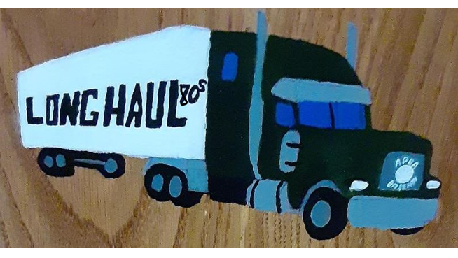
Long Haul – 1980’s
pitching Leaders of the 80’s

Slide 2
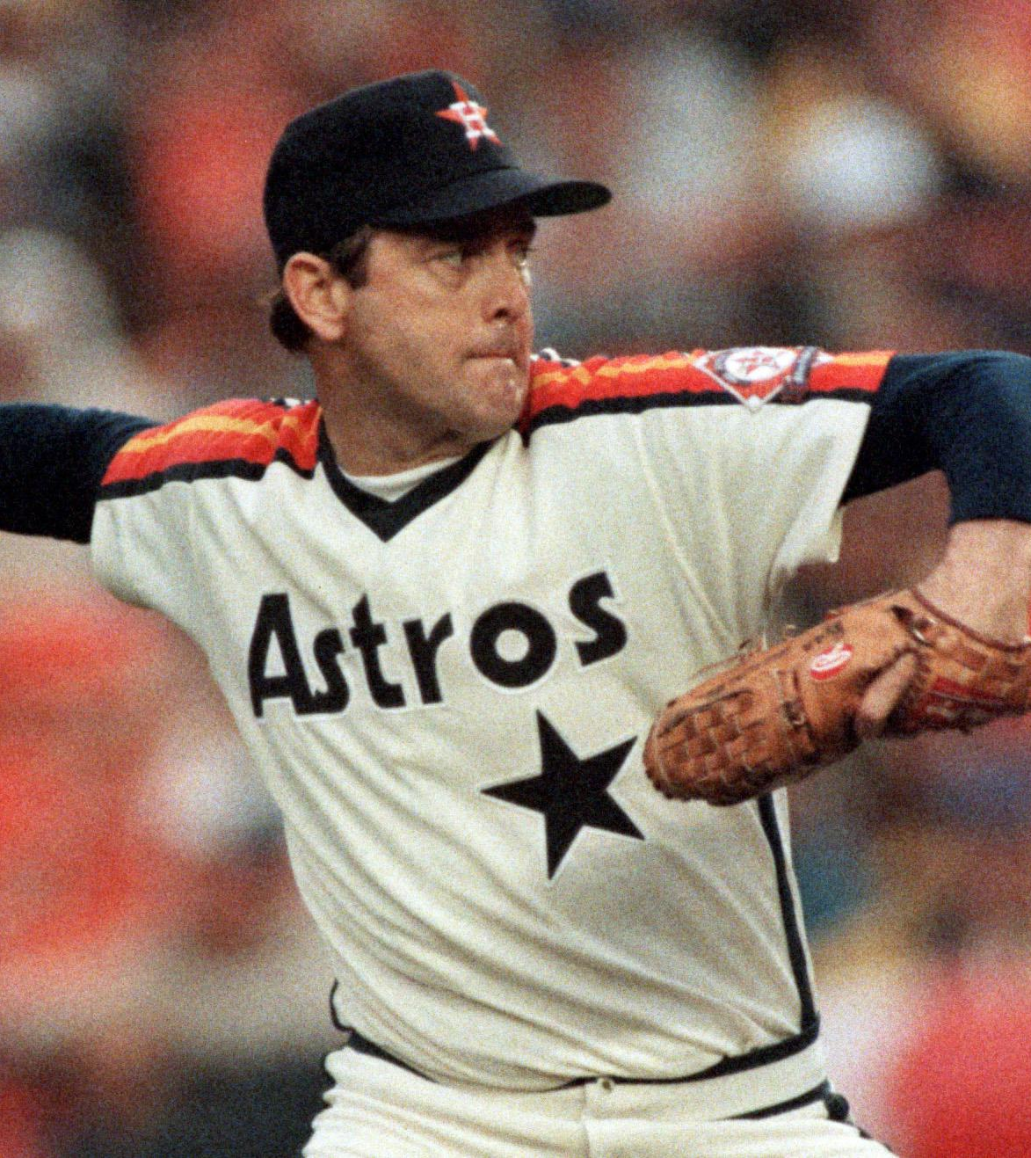
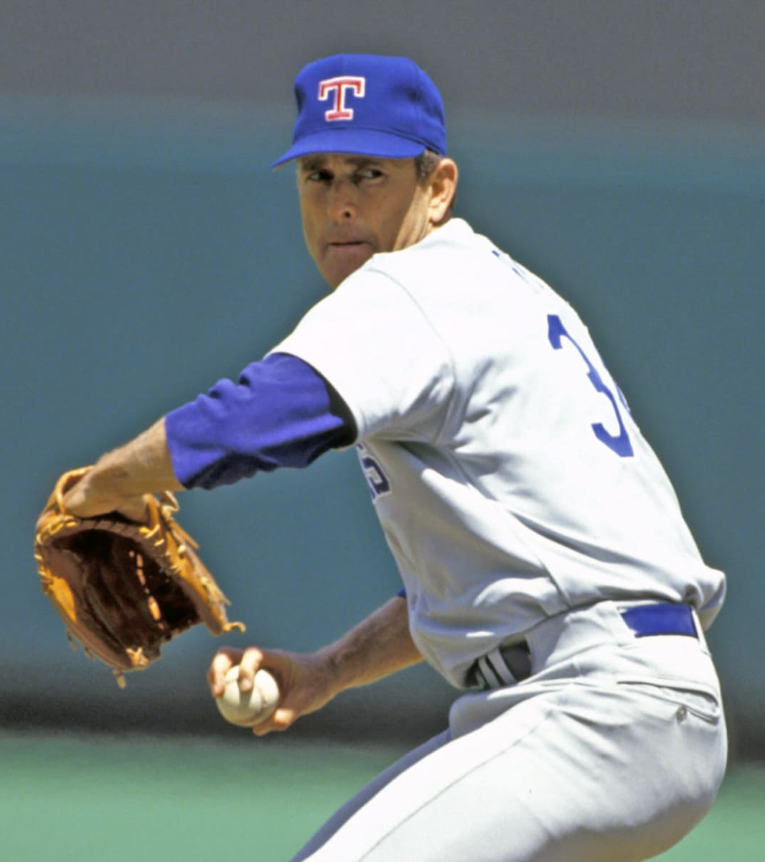
LONG HAUL – 80’S win LEADERS
Nolan Ryan 79
Bob Welch 69
Dave Stieb 59
Bert Blyleven 58
Danny Darwin 57
Fernando Valenzuela 56
John Tudor 56
Jerry Reuss 54
Orel Hershiser 54
Charlie Hough 51

Slide 3
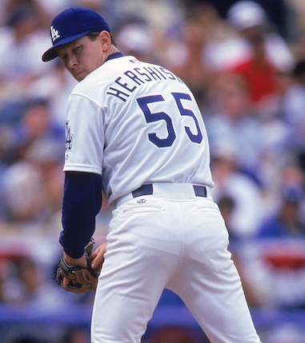
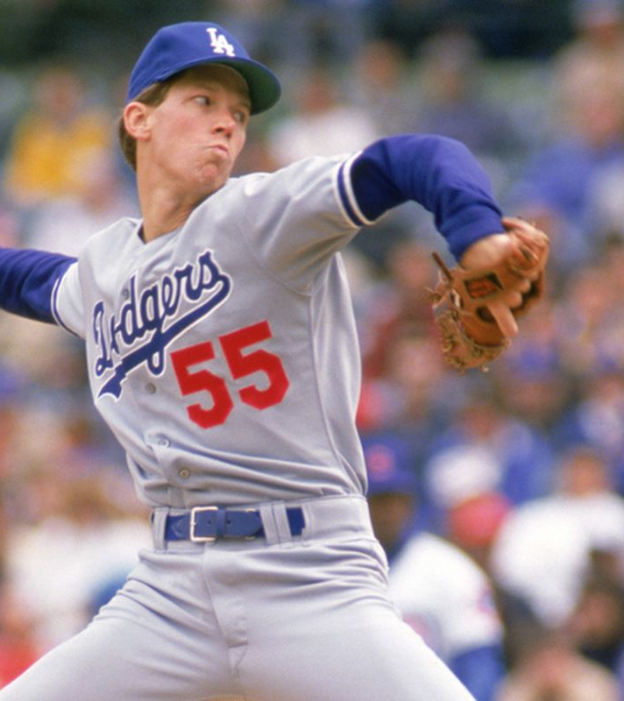
LONG HAUL – 80’S era LEADERS
Orel Hershiser 3.10 (291er in 843.2ip)
John Tudor 3.19 (289er in 815.1ip)
Jerry Reuss 3.21 (314er in 880.2ip)
Pascual Perez 3.24 (204er in 566.2ip)
Bert Blyleven 3.25 (344er in 954 ip)
Steve Carlton 3.34 (271er in 730.2ip)
Rick Honeycutt 3.37 (301er in 804.2ip)
Roger Clemens 3.40 (270er in 715.2ip)
Nolan Ryan 3.51 (483er in 1238.1ip)
Dave Stieb 3.52 (394er in 1008.1ip)
* Minimum 500 innings pitched

Slide 4
LONG HAUL – 80’S strikeout LEADERS
Nolan Ryan 1120
Jack Morris 787
Bob Welch 776
Steve Carlton 682
Fernando Valenzuela 676
Roger Clemens 660
Bert Blyleven 646
Dave Stieb 618
Ron Guidry 609
Dwight Gooden 599

Slide 5
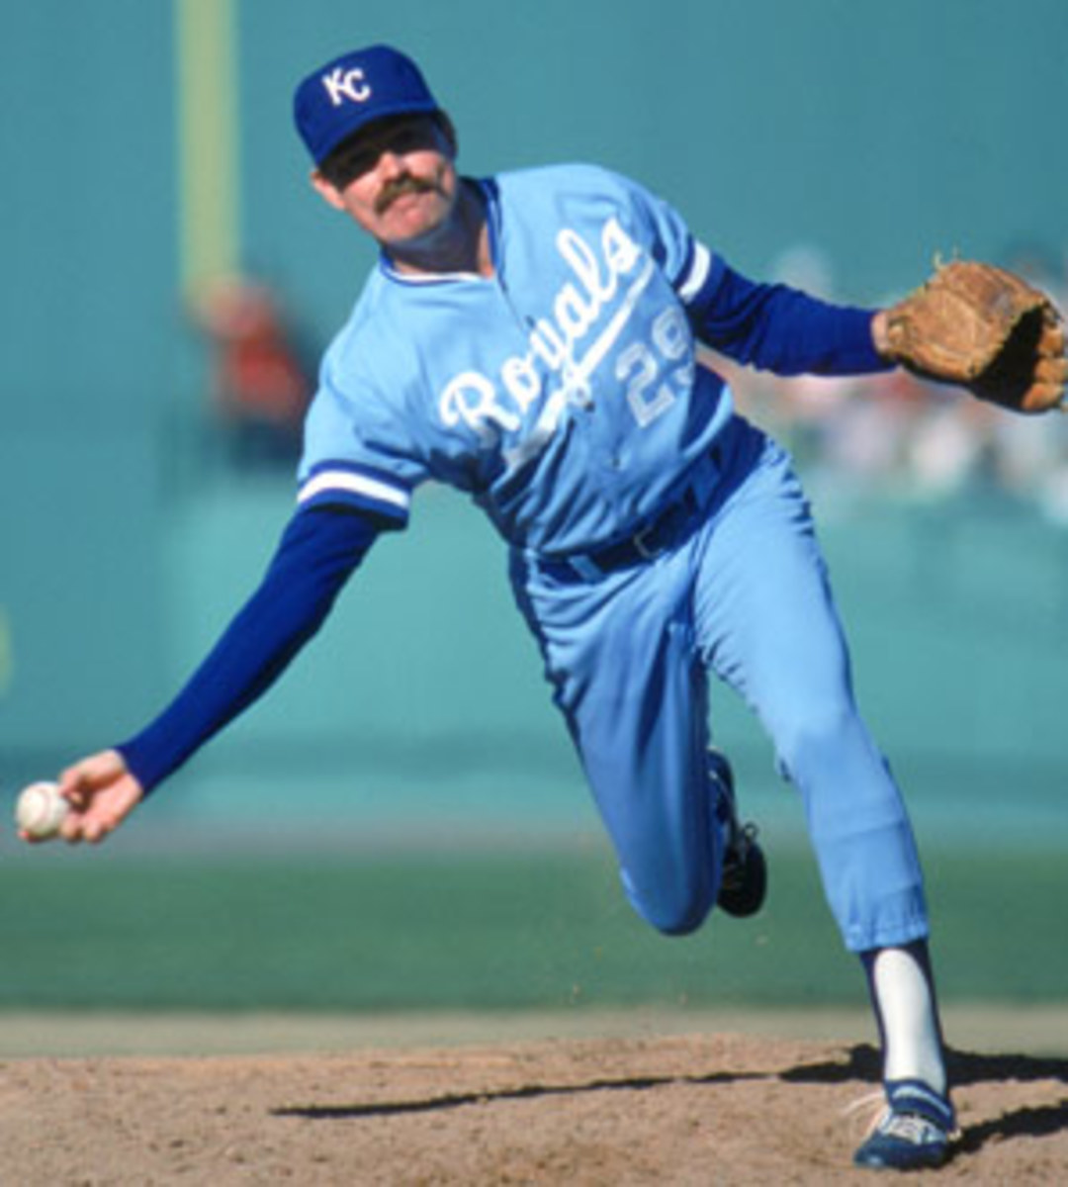
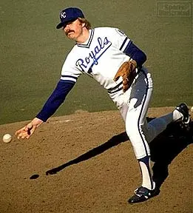
LONG HAUL – 80’S saves LEADERS
Dan Quisenberry 80
Jeff Reardon 54
Jesse Orosco 43
Larry Andersen 36
Tim Burke 34
Tom Henke 34
Al Holland 33
Goose Gossage 32
Lee Smith 30
Doug Corbett 29

Slide 6
LONG HAUL – 80’S whip LEADERS
Orel Hershiser 1.029
Bert Blyleven 1.051
John Tudor 1.053
Steve Carlton 1.054
Bret Saberhagen 1.090
Jerry Reuss 1.093
Roger Clemens 1.104
Dave Stewart 1.114
Dave Righetti 1.120
Pascual Perez 1.137
* Minimum 500 Innings Pitched

Slide 7
LONG HAUL – 80’S APPEARANCES LEADERS
Dan Quisenberry 246
Goose Gossage 243
Jesse Orosco 243
Jeff Reardon 230
Dave Righetti 228
Greg Minton 224
Dennis Eckersley 219
Danny Darwin 201
Kent Tekulve 197
Nolan Ryan 187

Slide 8
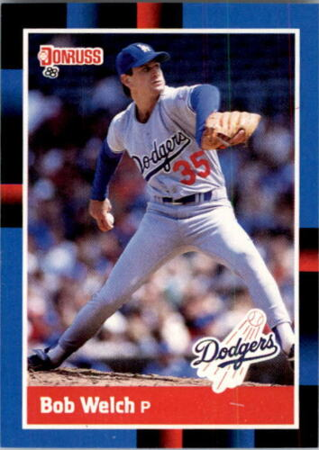
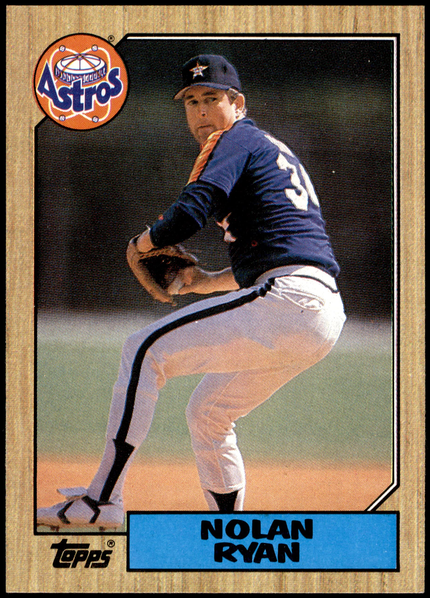
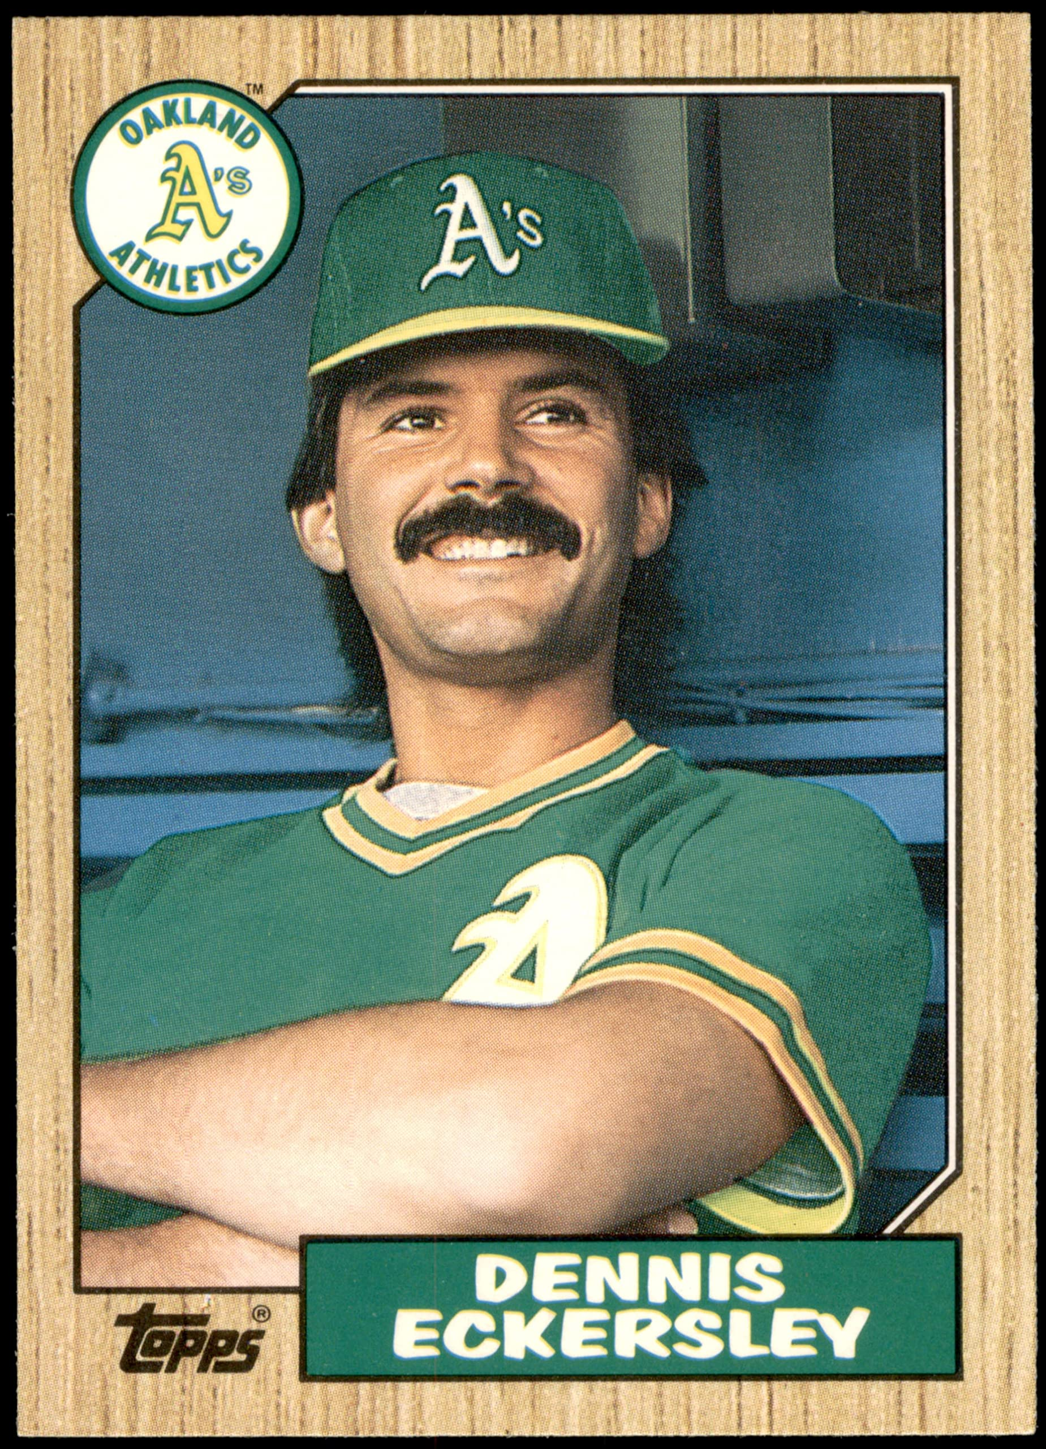
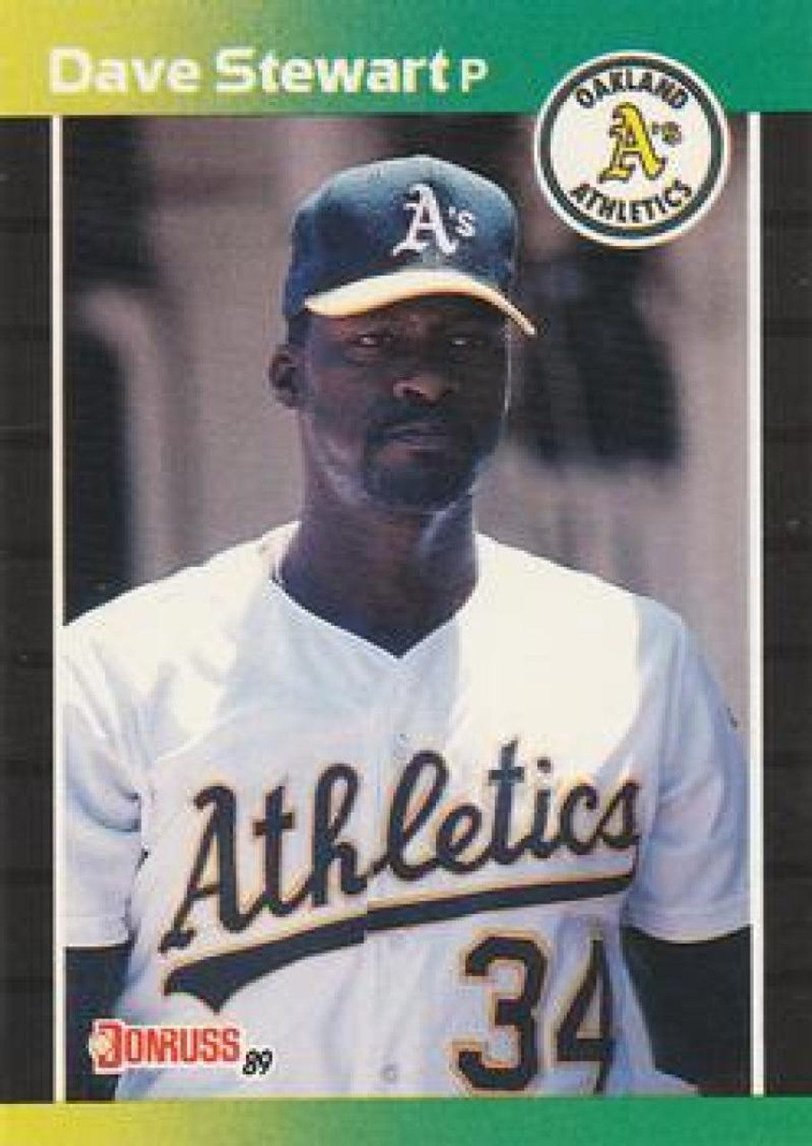
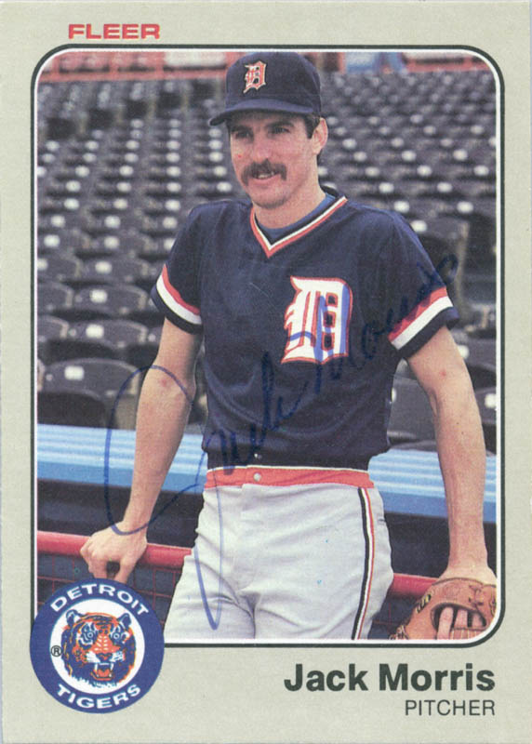
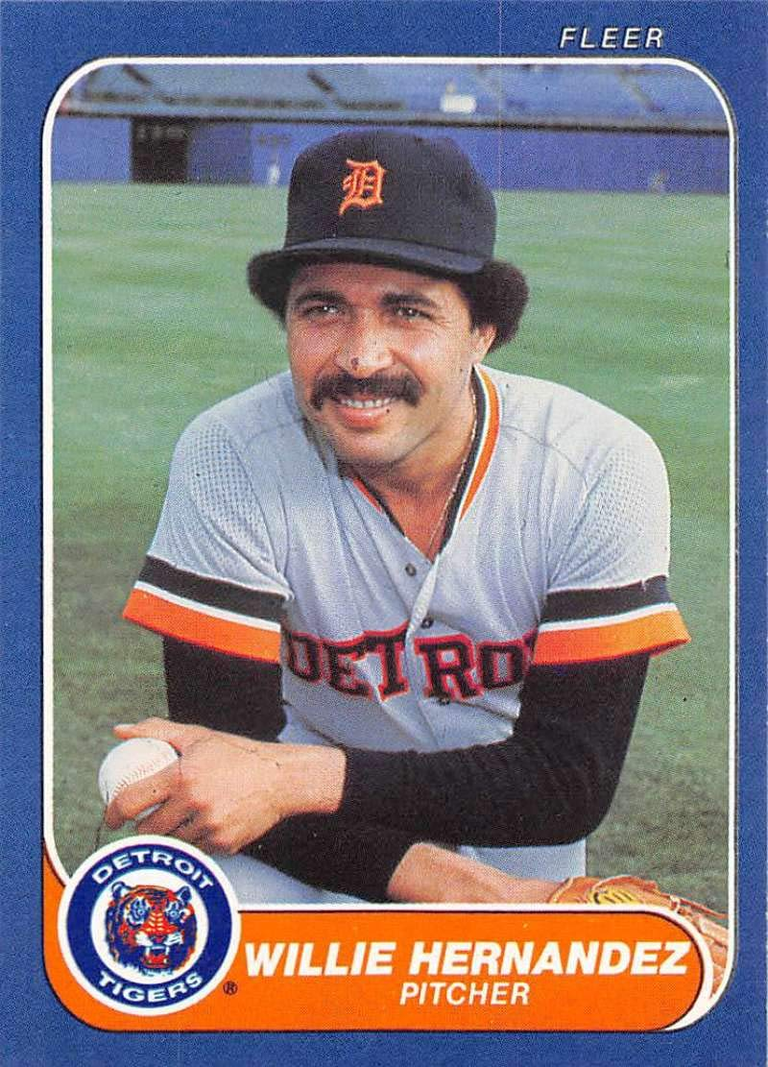
Miscellaneous leaders
Innings Pitched Losses
Nolan Ryan – 1238.1 Jack Morris - 90
Complete Games HR Allowed
Jack Morris – 107 Bob Welch - 143
Walks Allowed IBB Issued
Nolan Ryan - 528 Dennis Eckersley – 104
Most Hit Batters Most Balks
Jack Morris - 32 Dave Stewart – 6
Most Wild Pitches Most Inherited Runners
Nolan Ryan – 14 Guillermo Hernandez - 202

