Slide 1
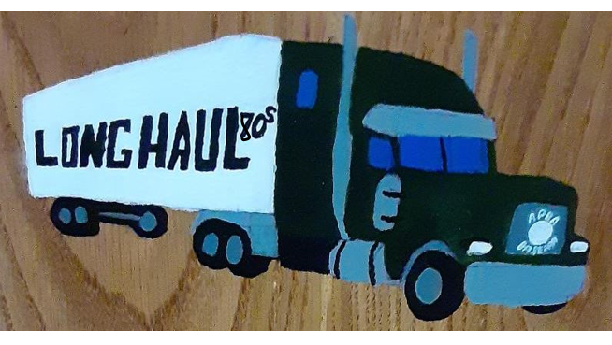
Long Haul – 1980’s
Batting Leaders of the 80’s

Slide 2
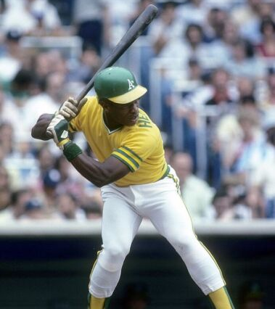
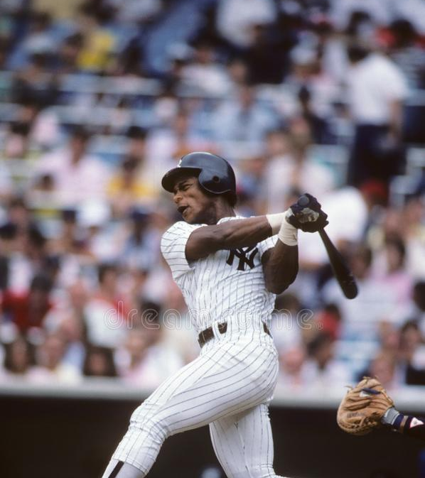
LONG HAUL – 80’S HIT LEADERS
Rickey Henderson 734
Tim Raines 730
Tony Gwynn 727
Wade Boggs 720
Robin Yount 705
Carney Lansford 700
George Brett 690
Andre Dawson 689
Willie McGee 628
Jack Clark 598

Slide 3
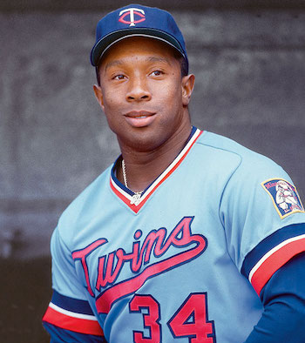
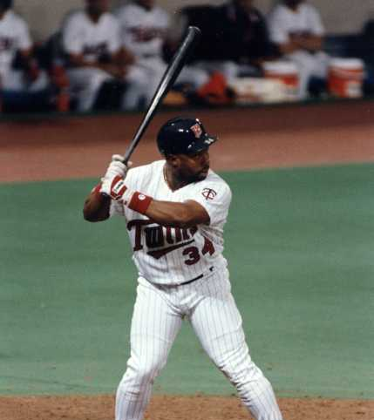
LONG HAUL – 80’S batting average LEADERS
Kirby Puckett .321 (596-1857)
Wade Boggs .312 (720-2305)
Mike Easler .302 (341-1131)
Juan Beniquez .298 (299-1005)
Tony Gwynn .296 (727-2453)
Mookie Wilson .279 (333-1192)
Terry Puhl .278 (383-1379)
Lee Lacy .278 (444-1599)
Jerry Mumphrey .277 (414-1492)
Don Mattingly .276 (550-1995)
* Minimum 1000 plate appearances

Slide 4
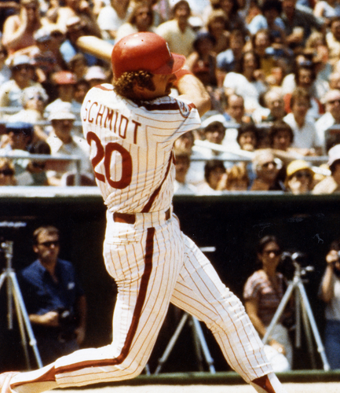
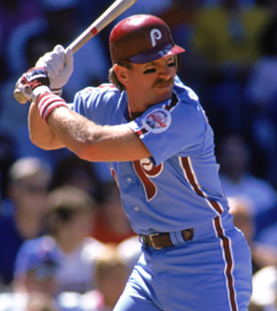
LONG HAUL – 80’S HOME RUN LEADERS
Mike Schmidt 178
Jack Clark 143
Eddie Murray 129
Andre Dawson 128
Lance Parrish 128
Dale Murphy 126
Jesse Barfield 123
Dave Winfield 121
Daryl Strawberry 115
Kent Hrbek 111

Slide 5
LONG HAUL – 80’S RBI LEADERS
Mike Schmidt 482
Jack Clark 435
George Brett 420
Andre Dawson 402
Dale Murphy 400
Dave Winfield 395
Eddie Murray 386
Robin Yount 364
Kent Hrbek 363
Dwight Evans 359

Slide 6
LONG HAUL – 80’S runs scored LEADERS
Rickey Henderson 557
Tim Raines 469
Mike Schmidt 457
George Brett 409
Jack Clark 402
Wade Boggs 381
Robin Yount 379
Kirk Gibson 377
Lonnie Smith 377
Dwight Evans 369

Slide 7
LONG HAUL – 80’S stolen bases LEADERS
Rickey Henderson 509
Tim Raines 384
Lonnie Smith 213
Vince Coleman 209
Brett Butler 183
Ozzie Smith 170
Willie McGee 165
Paul Molitor 161
Steve Sax 161
Willie Wilson 160

Slide 8
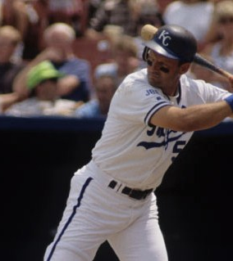
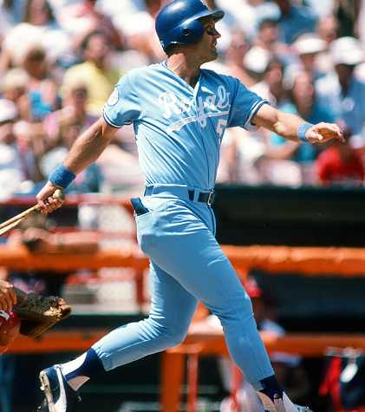
LONG HAUL – 80’S DOUBLES LEADERS
George Brett 194
Robin Yount 169
Andre Dawson 159
Wade Boggs 154
Dwight Evans 152
Tim Raines 145
Johnny Ray 139
Bill Buckner 138
Carney Lansford 137
Keith Hernandez 135

Slide 9
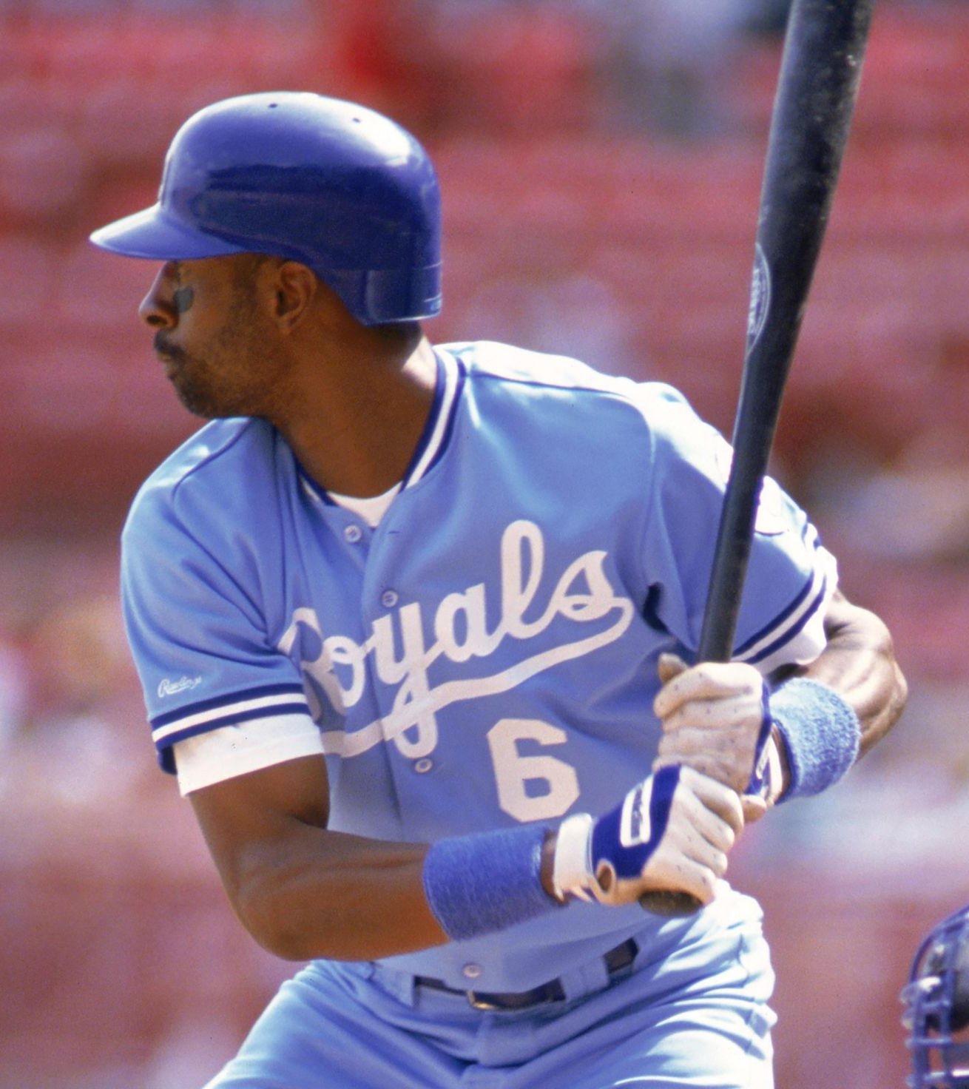
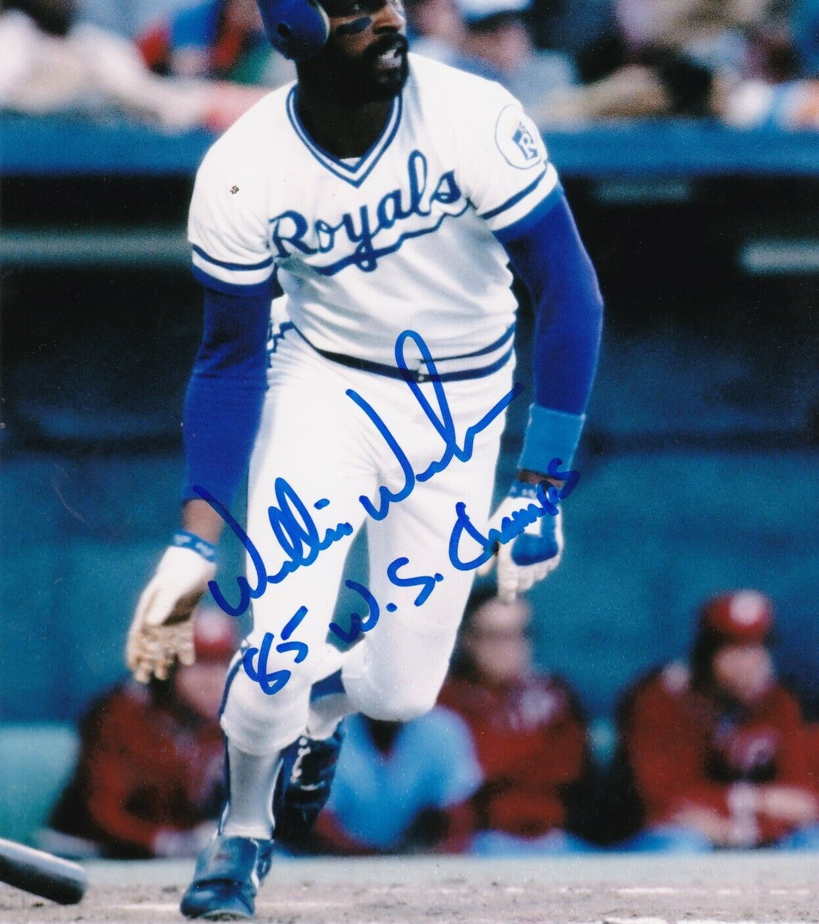
LONG HAUL – 80’S triples LEADERS
Willie Wilson 46
Robin Yount 44
Brett Butler 42
Willie McGee 38
Tony Gwynn 33
Andre Dawson 32
Tim Raines 32
Juan Samuel 32
Chet Lemon 30
Ryne Sandberg 30

Slide 10
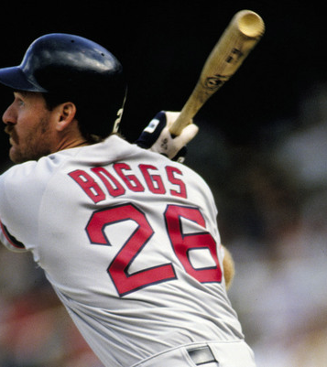
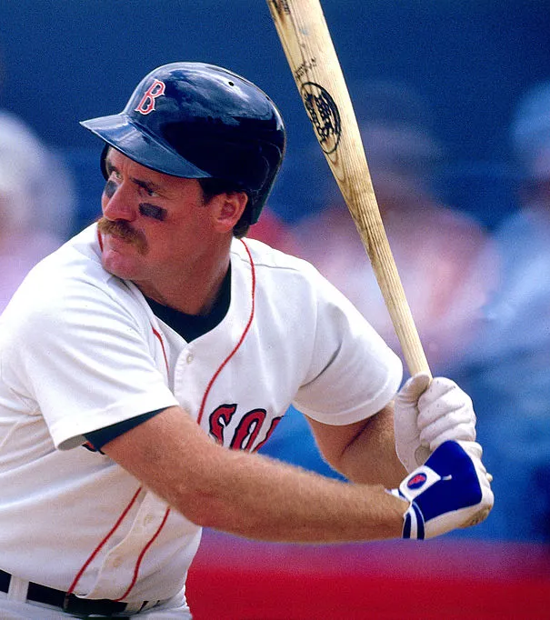
LONG HAUL – 80’S OBP LEADERS
Wade Boggs .407
Rickey Henderson .371
Ken Phelps .367
Kal Daniels .365
Tim Raines .364
Jack Clark .359
Gary Matthews .353
Kirby Puckett .352
Mike Easler .348
Juan Beniquez .348
Dwight Evans .348
* Minimum 1000 plate appearances

Slide 11
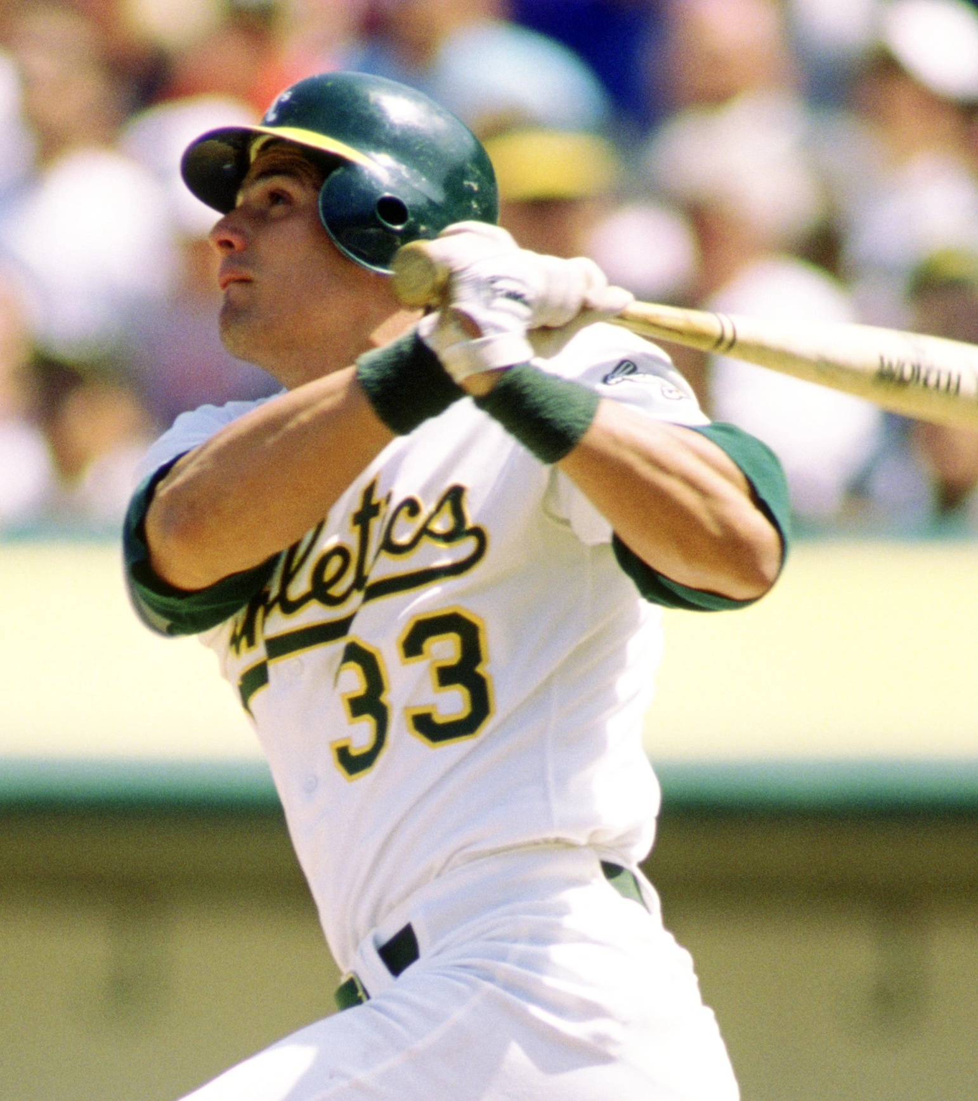
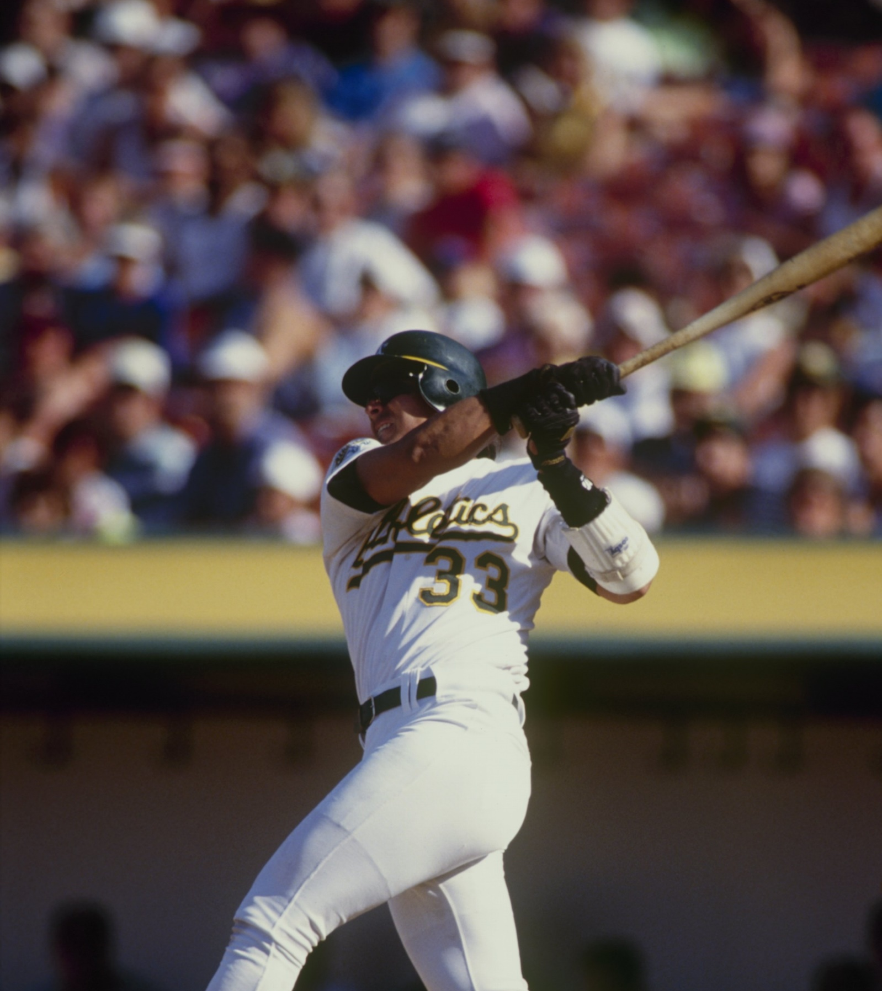
LONG HAUL – 80’S slugging % LEADERS
Jose Canseco .537
Mike Schmidt .513
Will Clark .503
Ken Phelps .502
Mike Easler .491
Don Mattingly .490
Daryl Strawberry .490
Jack Clark .484
Kent Hrbek .478
Greg Walker .474
* Minimum 1000 plate appearances

Slide 12
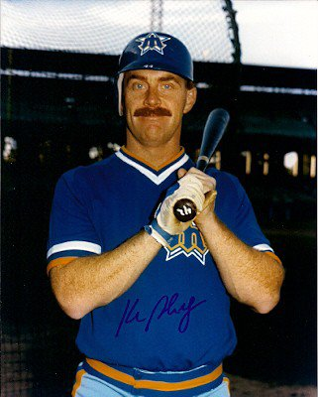
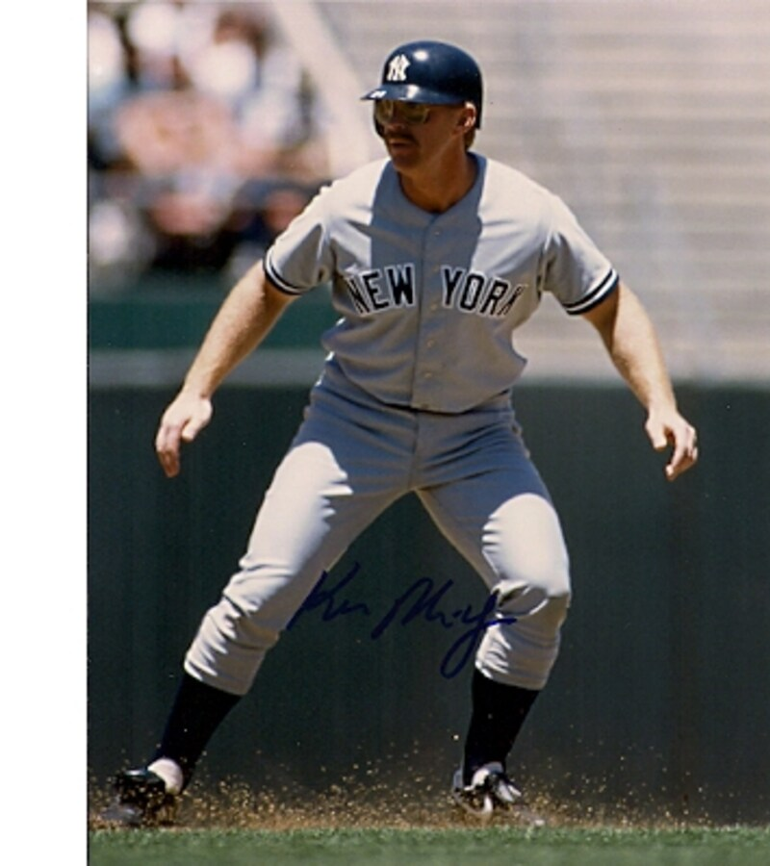
LONG HAUL – 80’S OPS LEADERS
Ken Phelps .869
Jose Canseco .864
Mike Schmidt .856
Wade Boggs .846
Jack Clark .843
Mike Easler .839
Will Clark .839
Don Mattingly .831
Kirby Puckett .823
Daryl Strawberry .817
* Minimum 1000 plate appearances

Slide 13
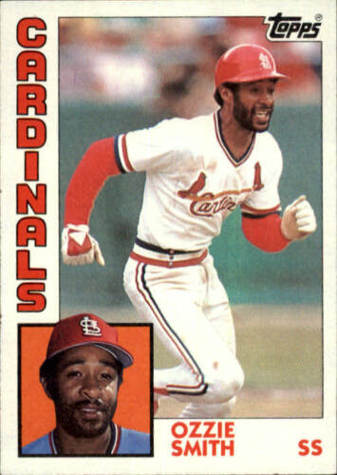
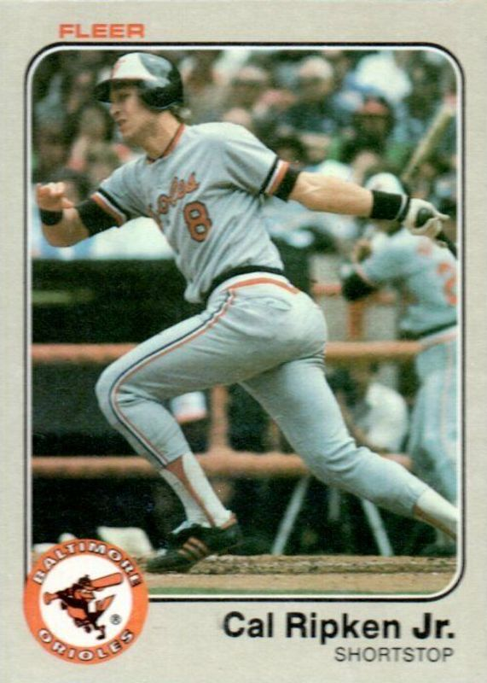
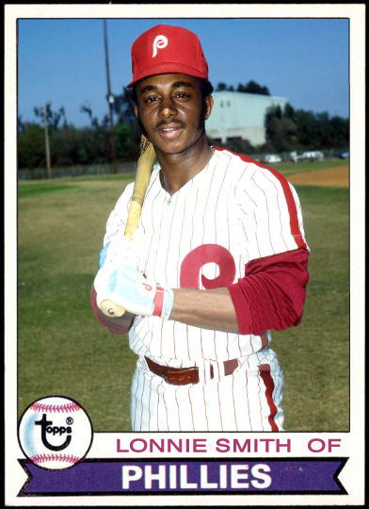
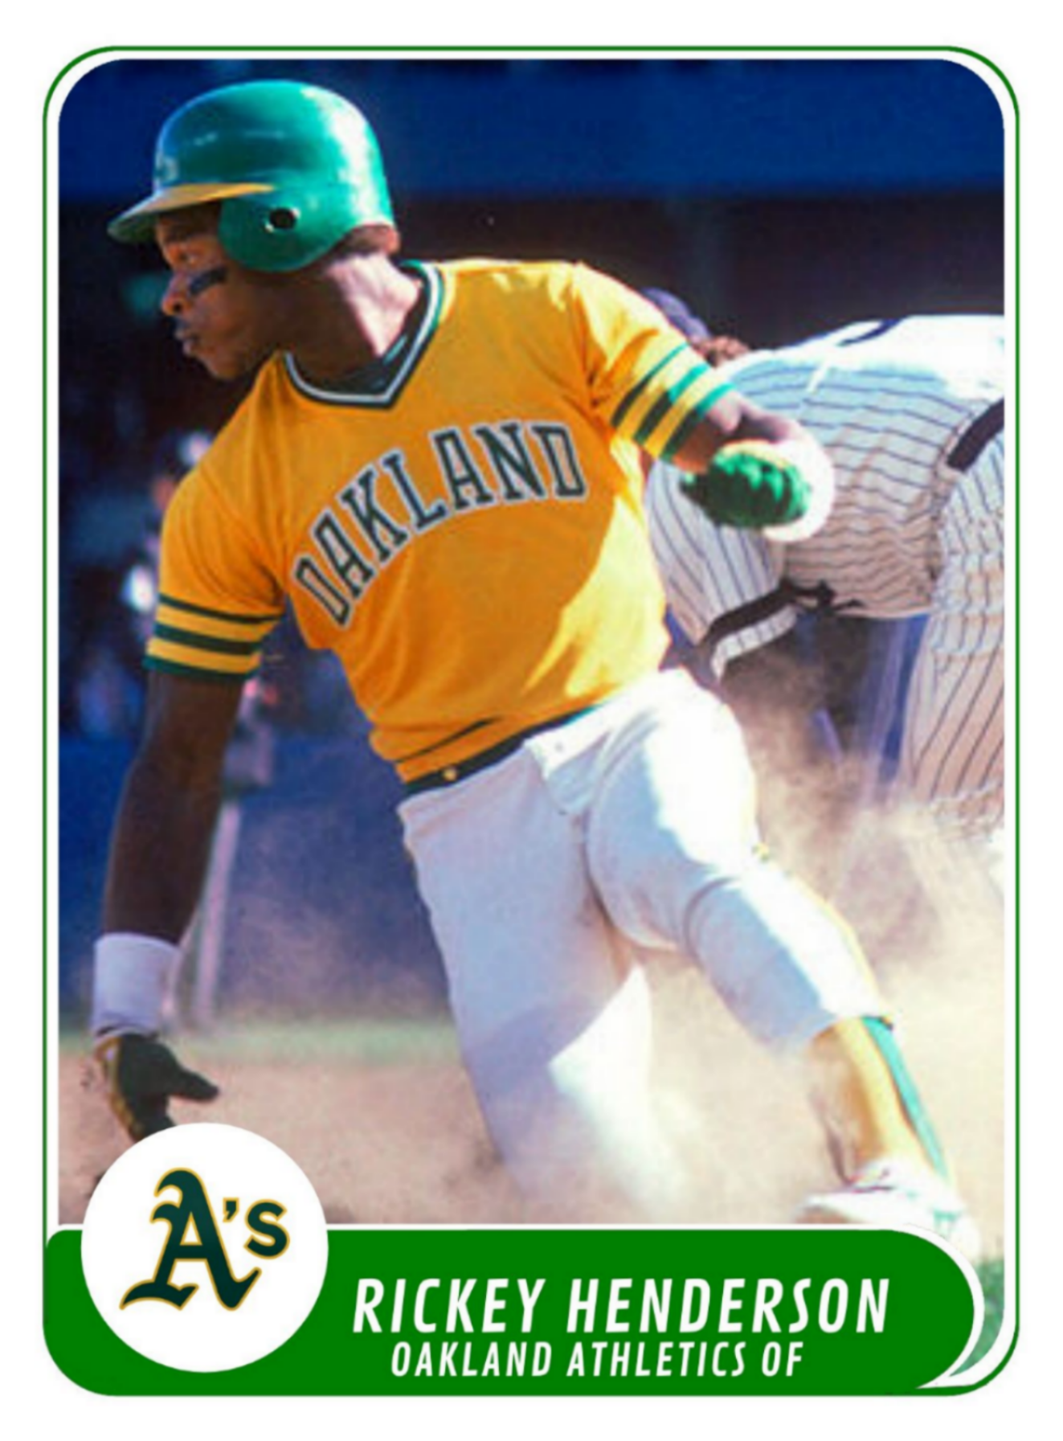
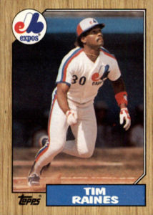
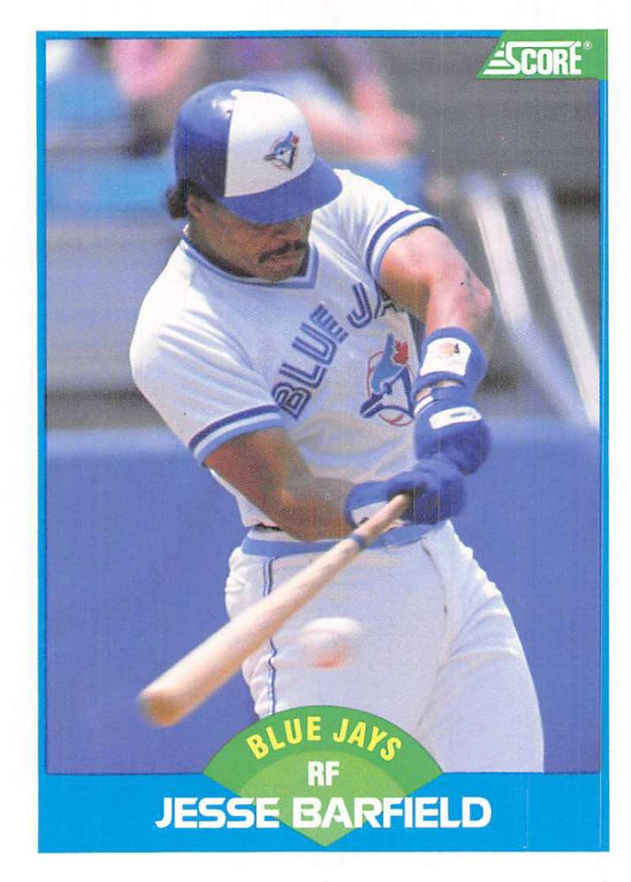
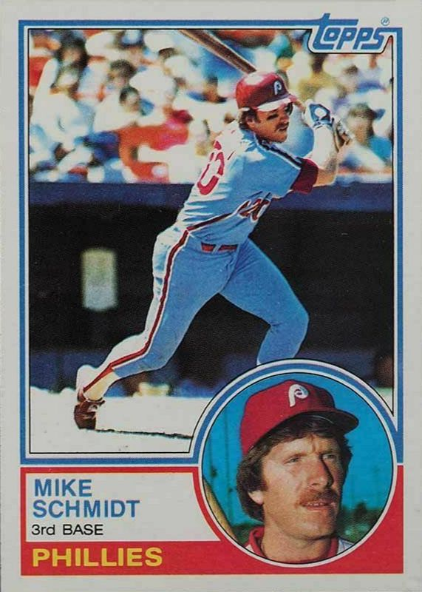
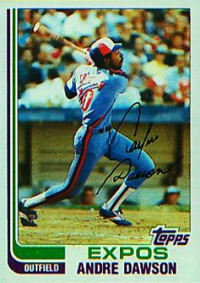
Miscellaneous leaders
Hit By Pitch Sacrifices
Lonnie Smith – 45 Ozzie Smith - 37
Games Played Sacrifice Flies
Rickey Henderson – 735 Cal Ripken - 27
Andre Dawson - 27
Walks
Rickey Henderson – 541 Intentionally Walked
Mike Schmidt - 99
Caught Stealing
Tim Raines – 47 Total Bases
Andre Dawson - 1296
Strikeouts
Jesse Barfield - 527

