Slide 1
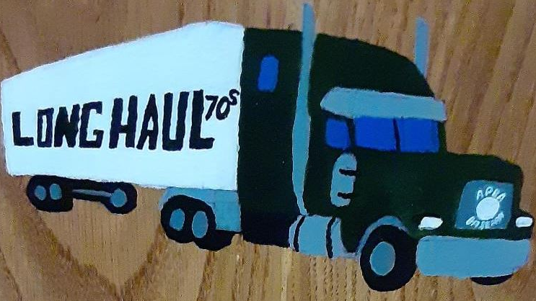
Long Haul All-Time Almanac
1970 - 1987

Slide 2
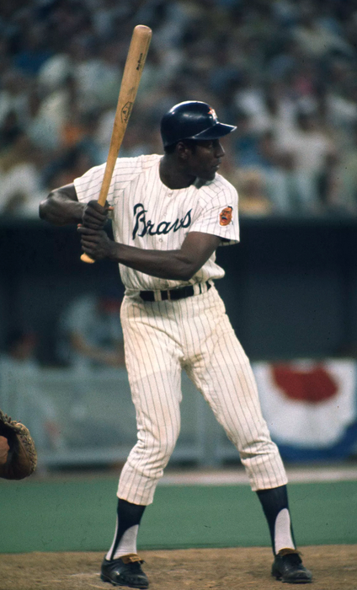
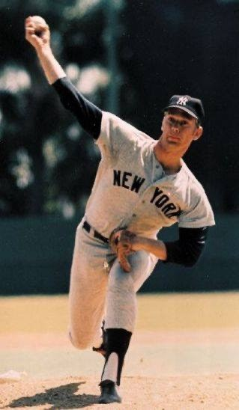
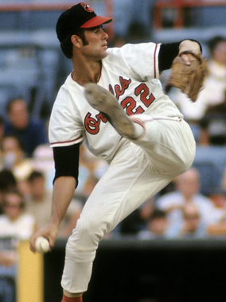
1970
Rico Carty
Stan Bahnsen
Jim Palmer
MVP CY Young
Rico Carty, Druk U 1. Jim Palmer Jax
Willie Stargell, REK 1. Stan Bahnsen, Olney (Tie)
Johnny Bench, LA 3. Wayne Granger, Druk U

Slide 3
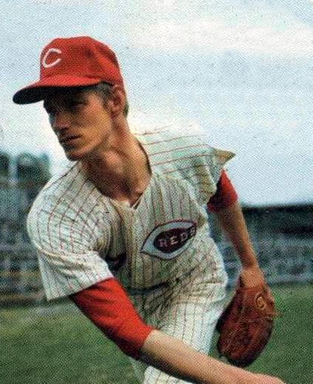
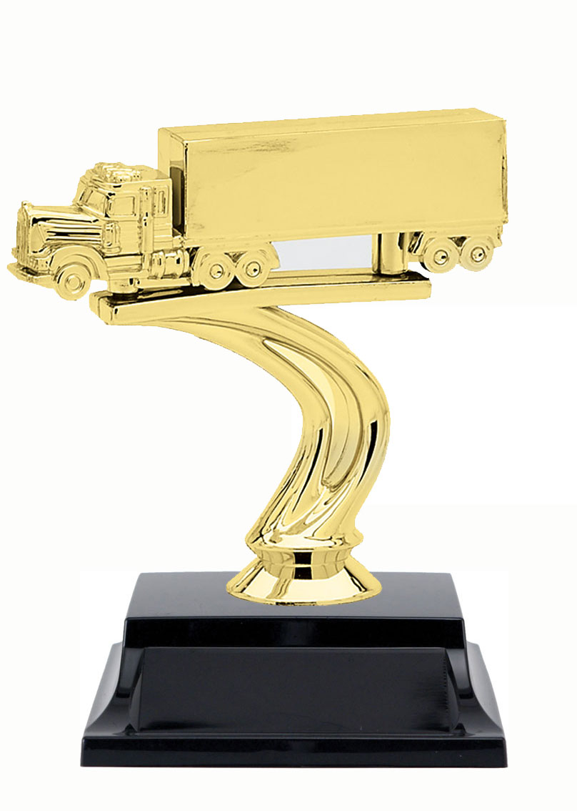
1970
MANAGER OF THE YEAR
DAVE DRUK
Wayne Granger
Fireman of the Year Manager
Wayne Granger, Druk U 1. Dave Druk, Druk U
Joe Hoener, REK 1. Paul Miller, LA
Mudcat Grant, LA 3. Larry Ridgeway, REK

Slide 4
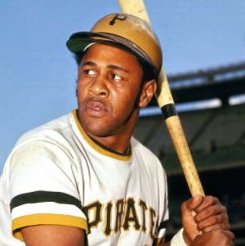
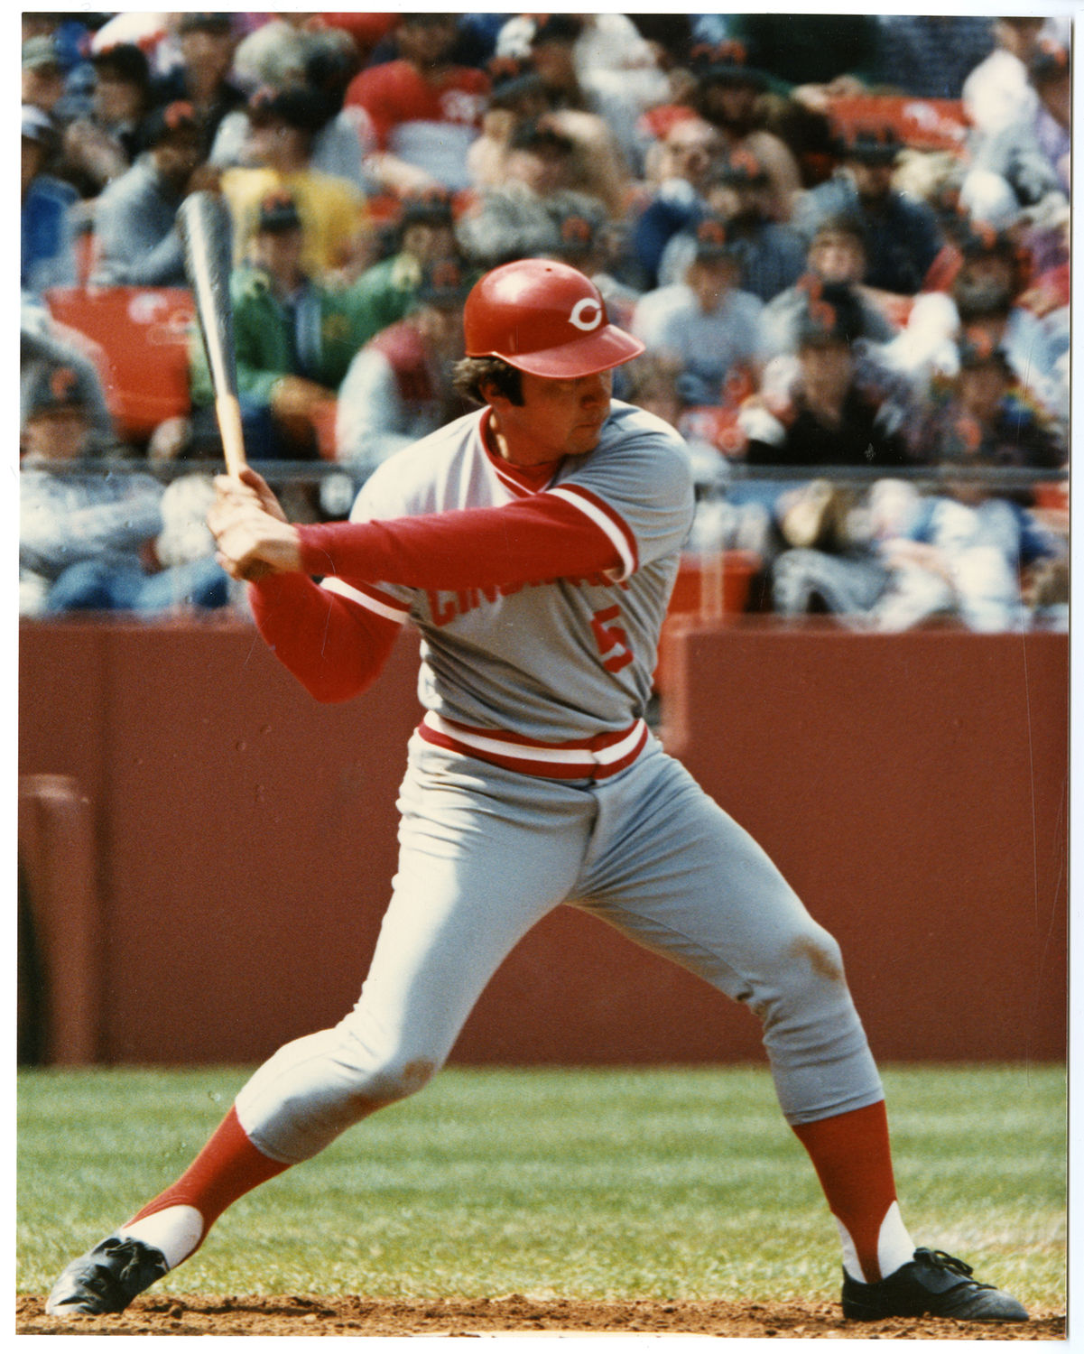
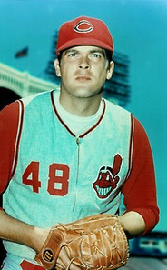
1970
Stargell
Bench
LEAGUE LEADERS
AVG – Rico Carty, Druk U (.403)
HR- Willie Stargell REK, Johnny Bench LA, Rico Carty Druk U (21)
RBI- Rico Carty, Druk U (72)
SB- Tommy Harper, GEMS (24)
ERA – Stan Bahnsen, Olney (2.49)
Wins- Jim Palmer, JAX (12)
Strikeouts – Sam McDowell, 45ers (111)
Saves – Wayne Granger, Druk U (22)
McDowell

Slide 5
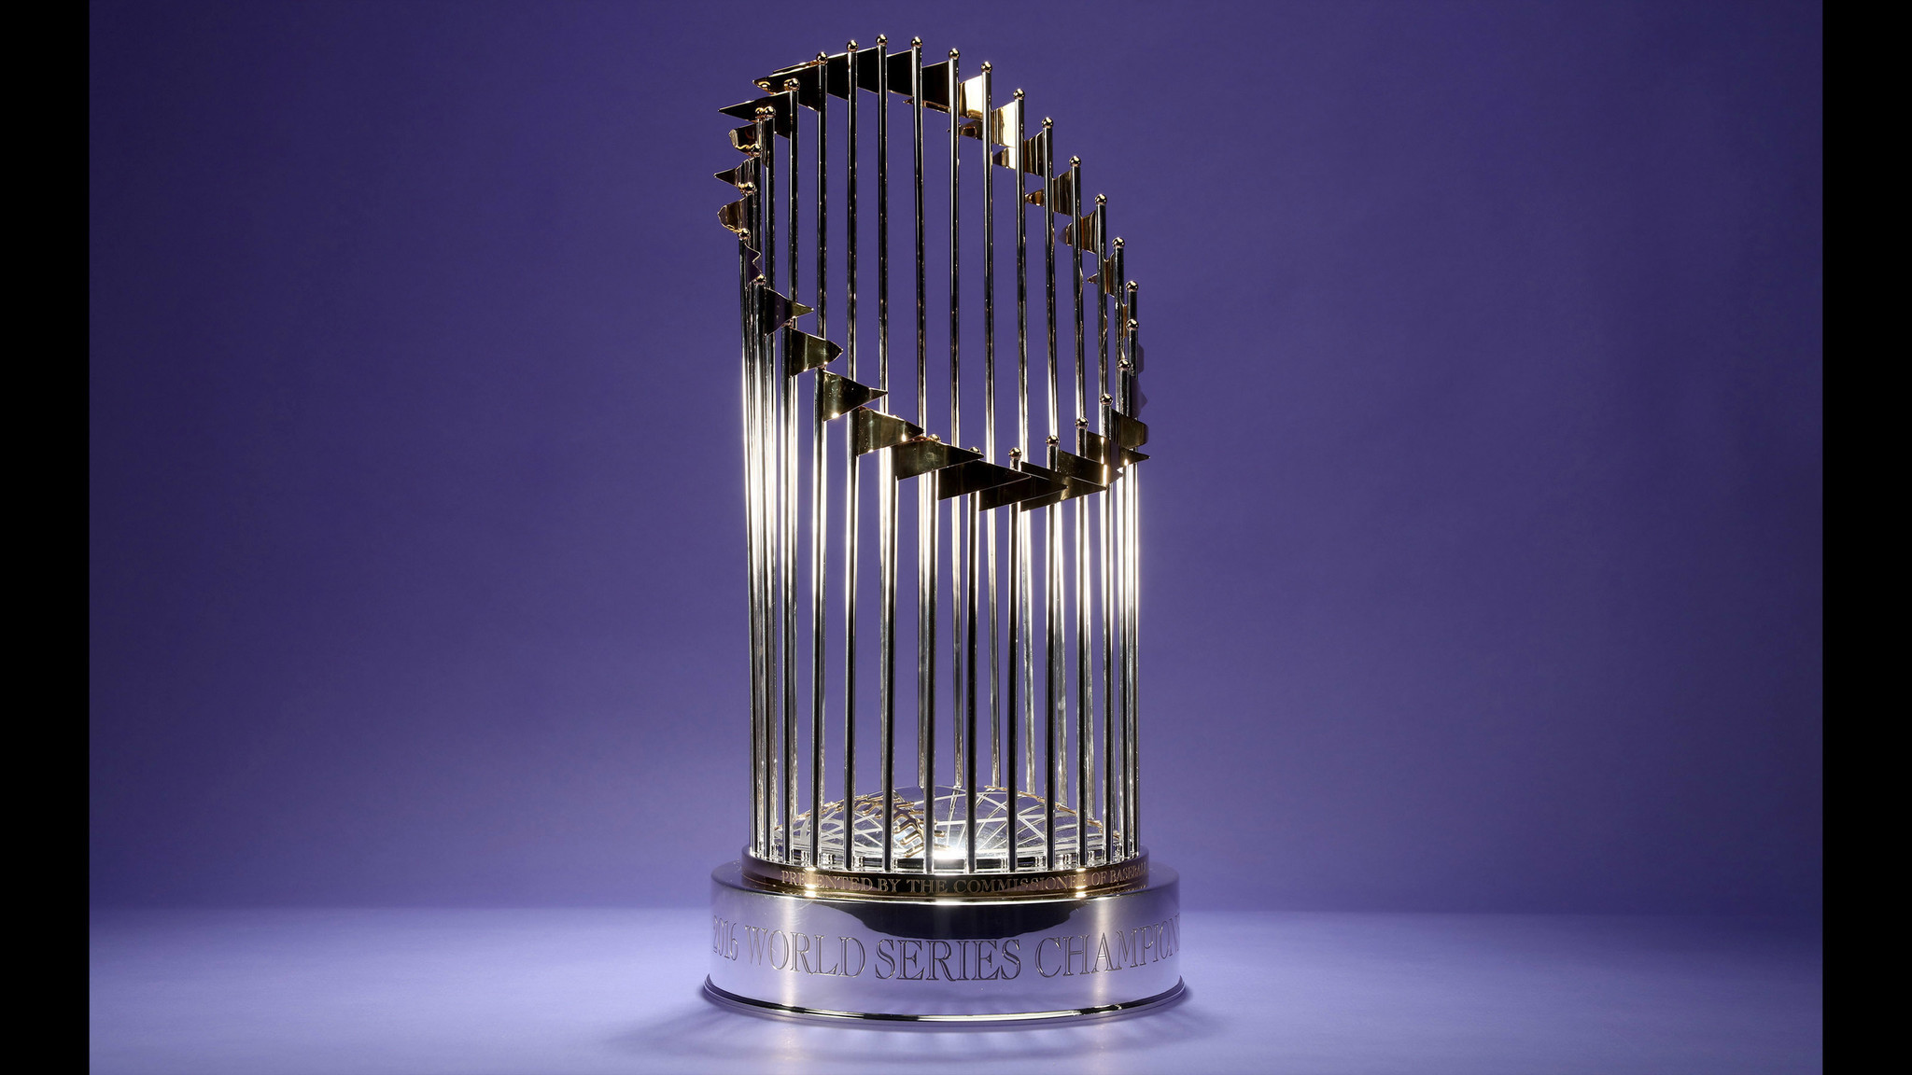
1970
Long Haul Champions
Lester A’s
Paul Miller

Slide 6
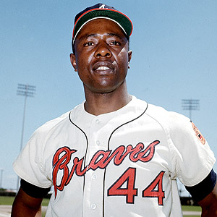
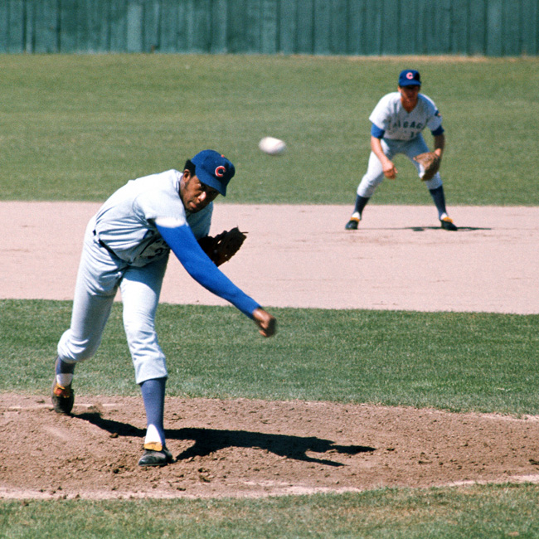
1971
Hank Aaron
Fergie Jenkins
MVP Cy Young
Hank Aaron, BPM 1. Fergie Jenkins, WSox
Bobby Murcer, WSoX 2. Tom Seaver, GEMS
Tony Oliva, CBB 3. Wilbur Wood, Druk U

Slide 7
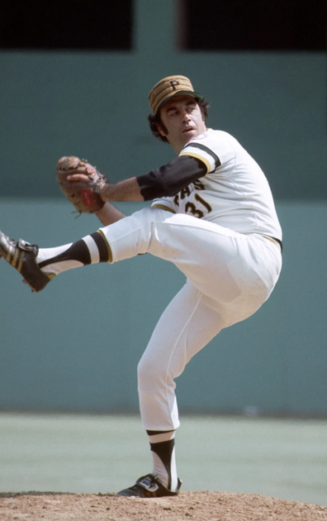
1971
MANAGER OF THE YEAR
AJ LUCKHAUPT
Dave Giusti
Fireman of the Year Manager
Dave Giusti, BPM 1. AJ Luckhaupt, BPM
Joe Hoerner, REK 2. Joe Deauseault, WSox
Bob Miller, Olney 3. John Cody, JAX

Slide 8
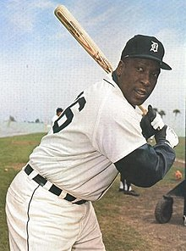
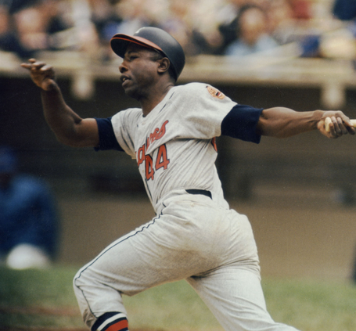
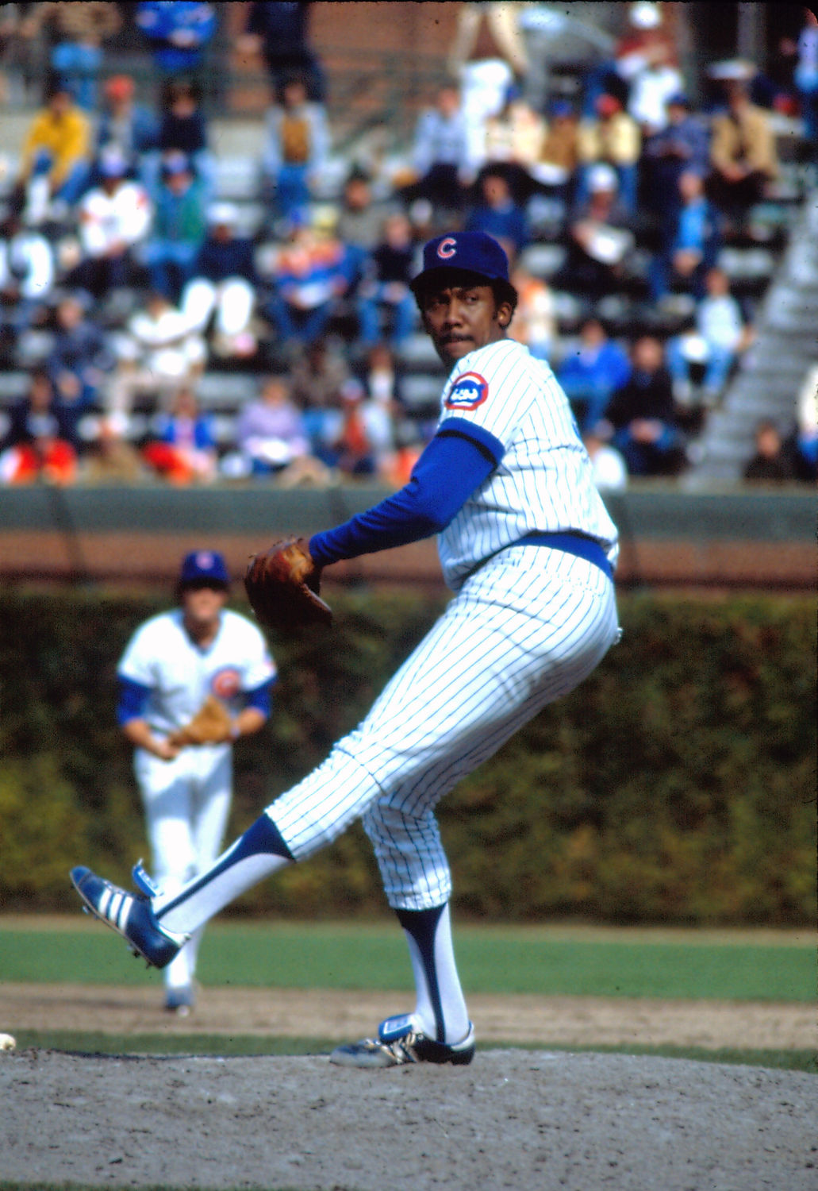
1971
Brown
Aaron
LEAGUE LEADERS
AVG – Gates Brown, Gems (.345)
HR- Hank Aaron, BPM (24)
RBI- Willie Stagell, REK, Hank Aaron BPM (51)
SB- Lou Brock, Stogies (31)
ERA – Fergie Jenkins, WSox (1.80)
Wins- Fergie Jenkins, WSox (11)
Strikeouts – Tom Seaver, Gems (119)
Saves – Dave Giusti, BPM (21)
Jenkins

Slide 9
1971
Long Haul Champions
Big Pink Machine
AJ Luckhaupt

Slide 10
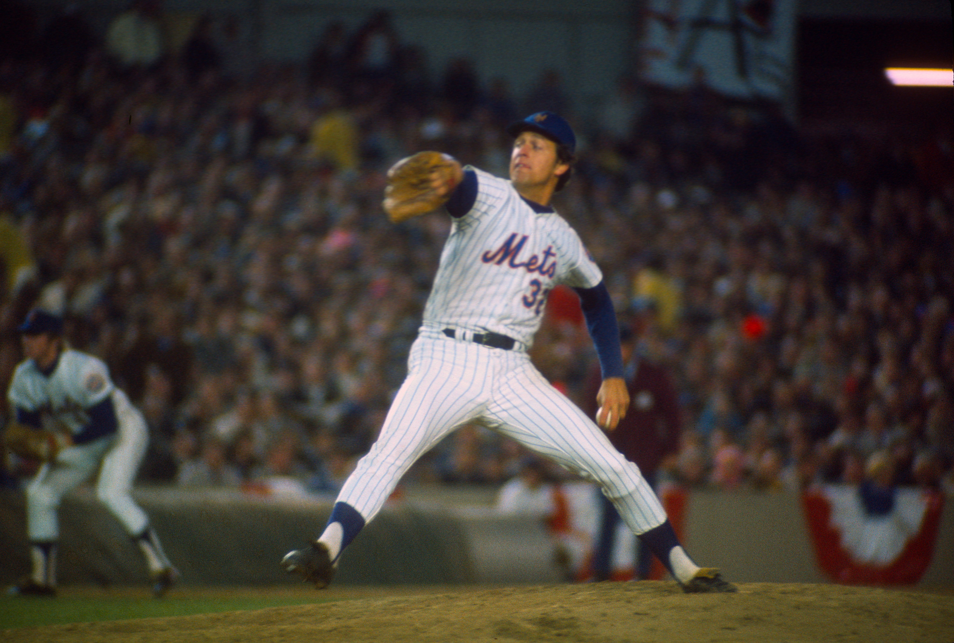
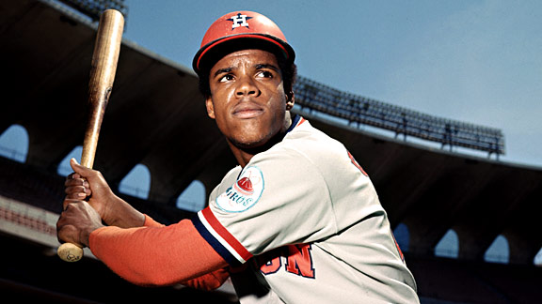
1972
Cesar Cedeno
Jon Matlack
MVP Cy Young
Cesar Cedeno, Gems 1. Jon Matlack, WSox
Billy Williams, BPM 2. Jim Palmer, JAX
Dick Allen, Olney 3. Gaylord Perry, Olney

Slide 11
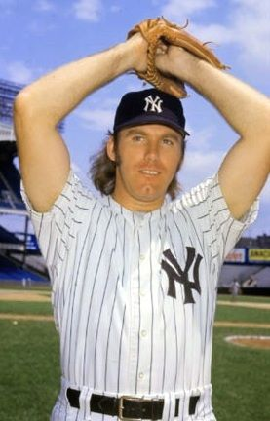
1972
MANAGER OF THE YEAR
JAY DEMAREST
Sparky Lyle
Fireman of the Year Manager
Sparky Lyle, Stogies 1. Jay Demarest, Olney
Rollie Fingers, WSox 2. AJ Luckhaupt, BPM
Lindy McDaniel, ROX 3. Joe Deauseault, WSox

Slide 12
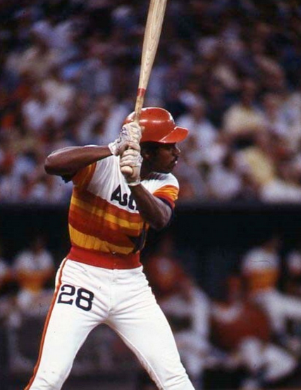
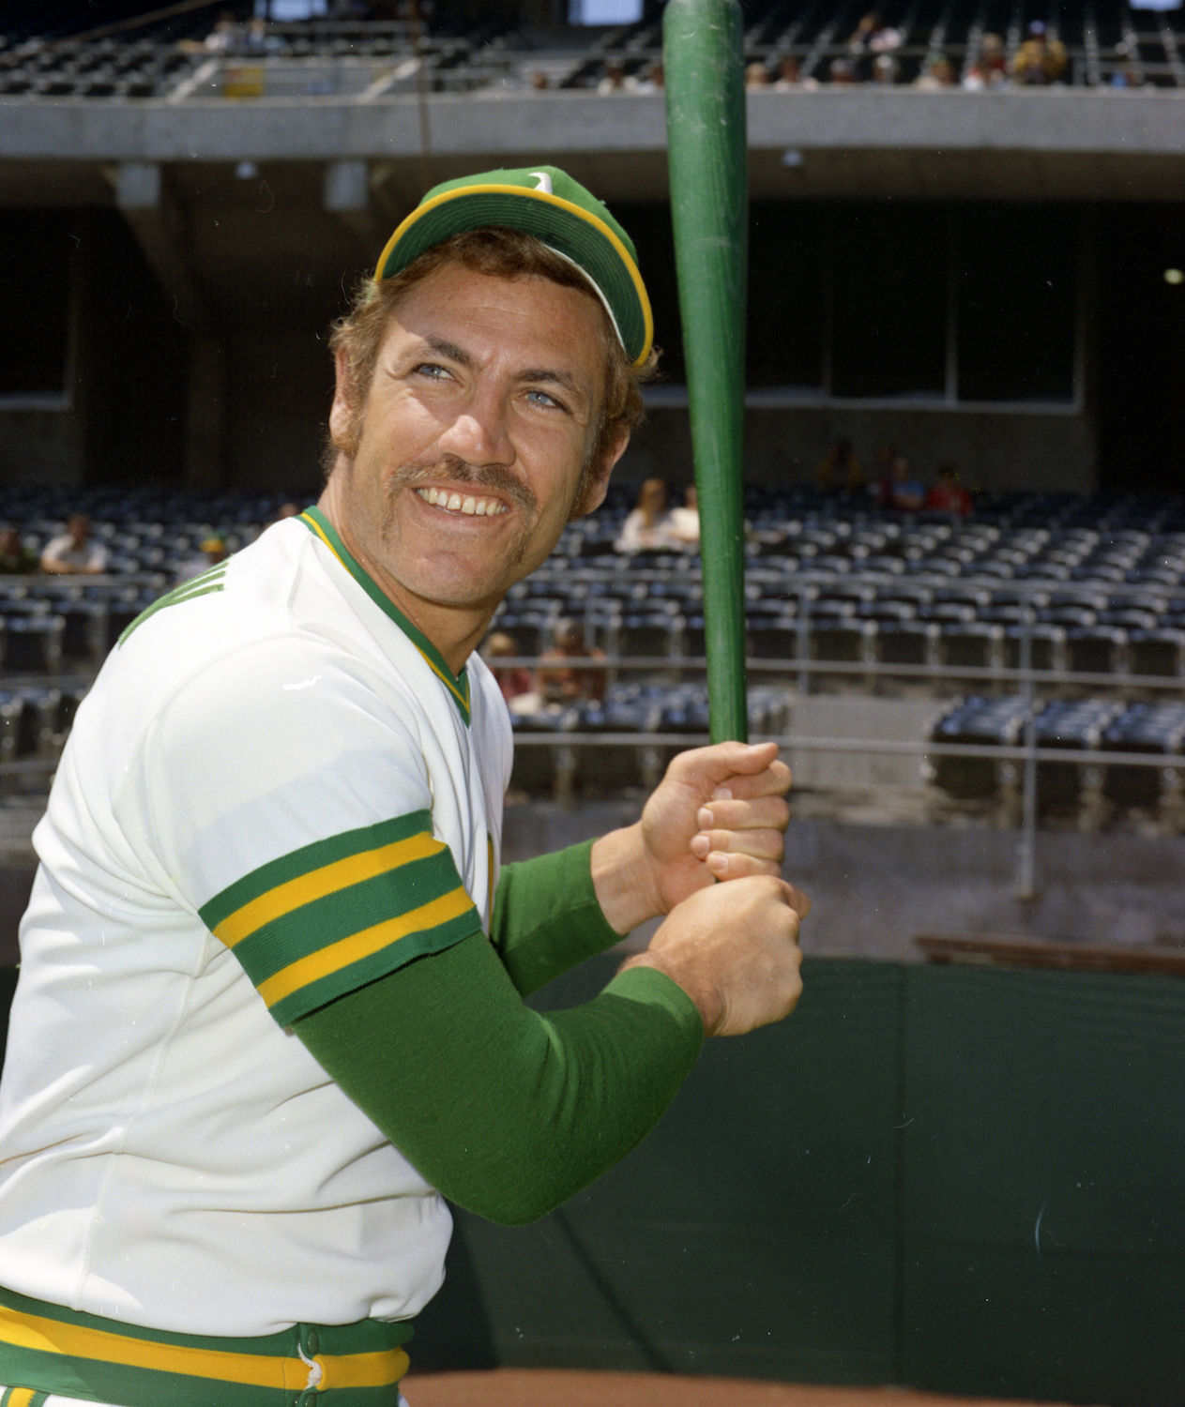
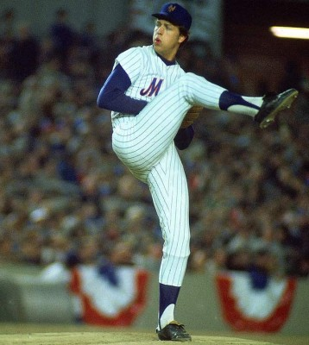
1972
Cedeno
Epstein
LEAGUE LEADERS
AVG – Cesar Cedeno, Gems (.335)
HR- Dick Allen, OO, Billy Williams, BPM (21)
RBI- Mike Epstein, OO (66)
SB- Cesar Cedeno, Gems (34)
ERA – Jon Matlack, WSox (1.43)
Wins- Jon Matlack, WSox (13)
Strikeouts – Nolan Ryan, Stogies (148)
Saves – Sparky Lyle, Stogies (13)
Matlack

Slide 13
1972
Long Haul Champions
Olney Ogres
Jay Demarest

Slide 14
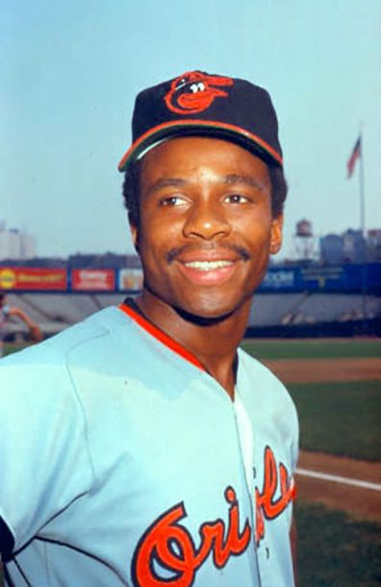
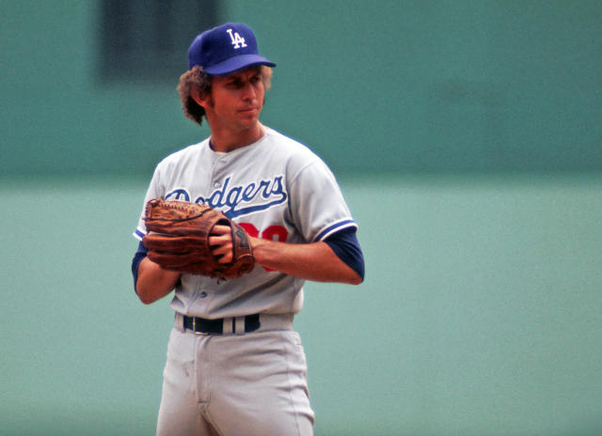
1973
Al Bumbry
Don Sutton
MVP Cy Young
Al Bumbry, Chico’s 1. Don Sutton, JAX
Dick Allen, Olney 2. Wilbur Wood, Druk U
3 tied 3. Bert Blyleven, REK

Slide 15
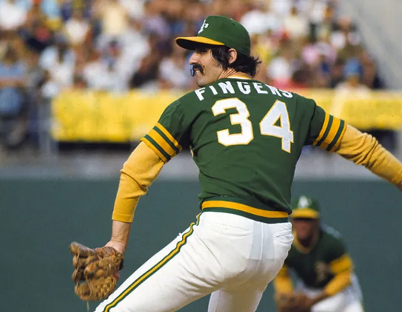
1973
Rollie Fingers
Fireman of the Year Manager
Rollie Fingers, WSox 1. Jay Demarest, Olney
John Hiller, Stogies 2. John Cody, JAX
Fred Beene, Olney 3. Allen Smith, 45ers

Slide 16
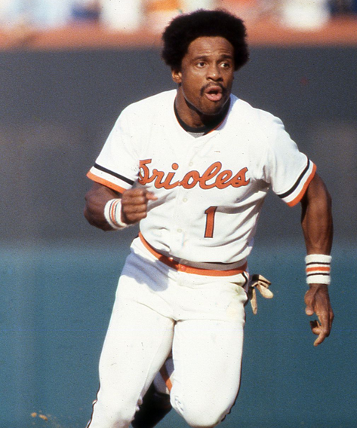
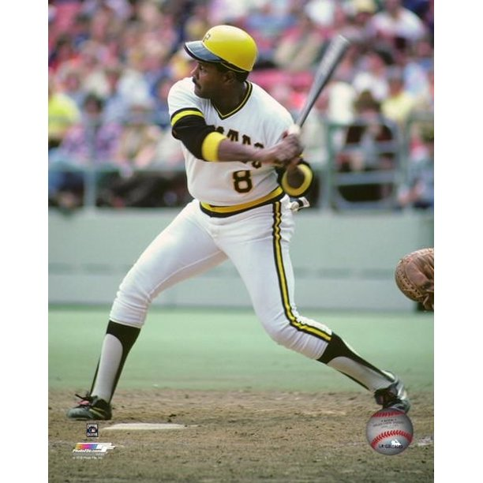
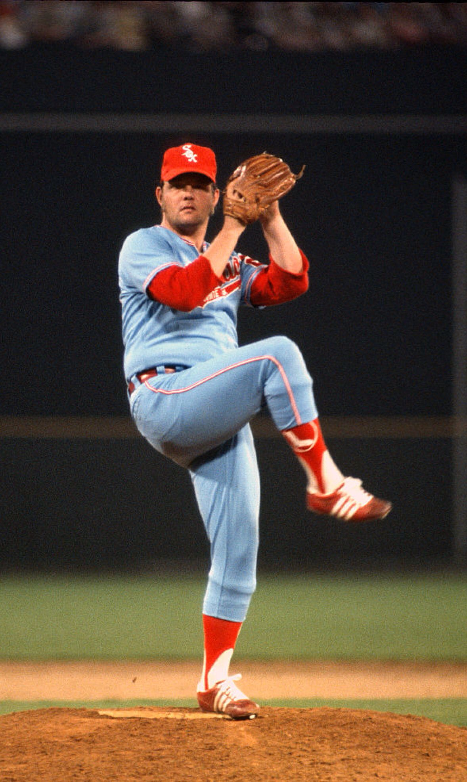
1973
Stargell
Bumbry
LEAGUE LEADERS
AVG – Al Bumbry, Chico’s (.363)
HR- Hank Aaron, BPM (22)
RBI- Willie Stargell, REK (50)
SB- Lou Brock, HHH (36)
ERA – Wilbur Wood, DrukU (1.22)
Wins- Don Sutton, JAX (13)
Strikeouts – Bert Blyleven, REK (107)
Saves – Rollie Fingers, WSox, John Hiller, Stogies (13)
Wood

Slide 17
1973
Long Haul Champions
Olney Ogres
Jay Demarest

Slide 18
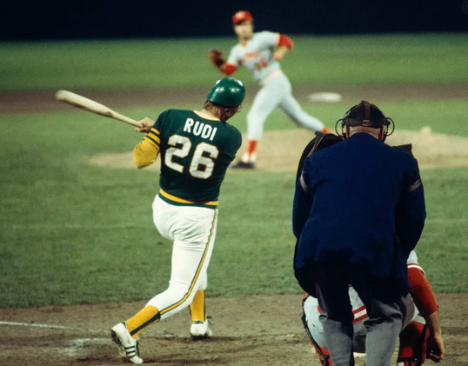
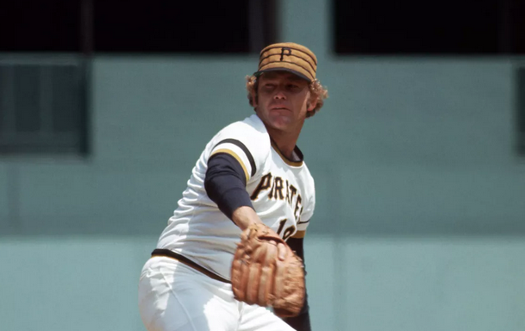
1974
Jim Rooker
Joe Rudi
MVP Cy Young
Joe Rudi, SVS 1. Jim Rooker, SVS
Reggie Smith, WSox 2. Buzz Capra, Chico’s
Ralph Garr, Wsox 3. Fergie Jenkins, WSox

Slide 19
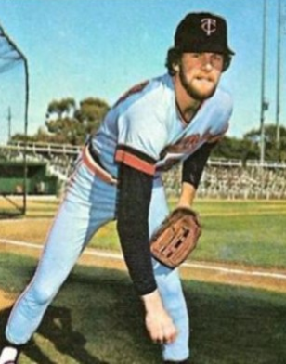
1974
MANAGER OF THE YEAR
KEN SCHULZ
Bill Campbell
Fireman of the Year Manager
Bill Campbell, HHH 1. Ken Schulz, SVS
Grant Jackson, 45ers 2. Andy Luckhardt, Chico’s
Mike Marshall, Olney 3. Jay Demarest, Olney

Slide 20
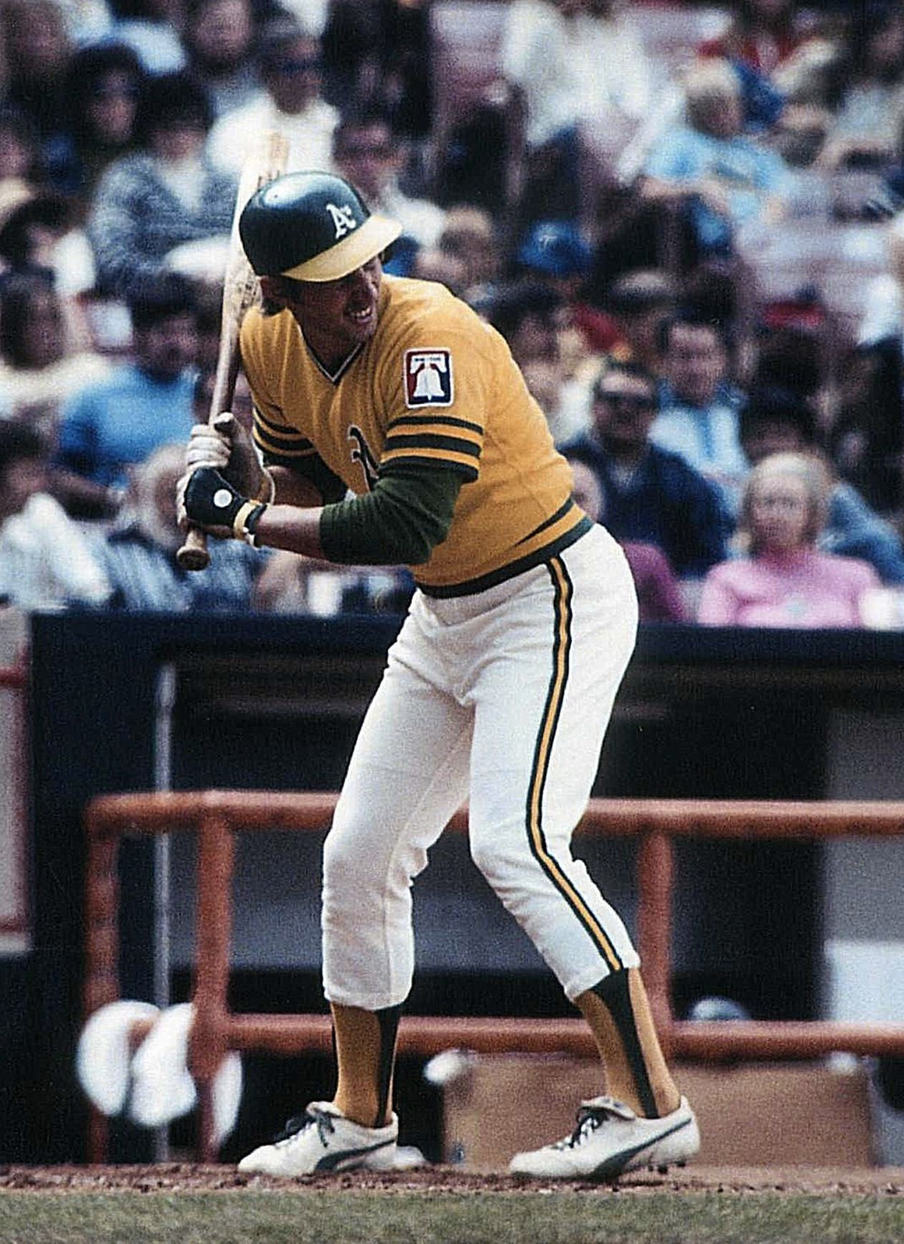
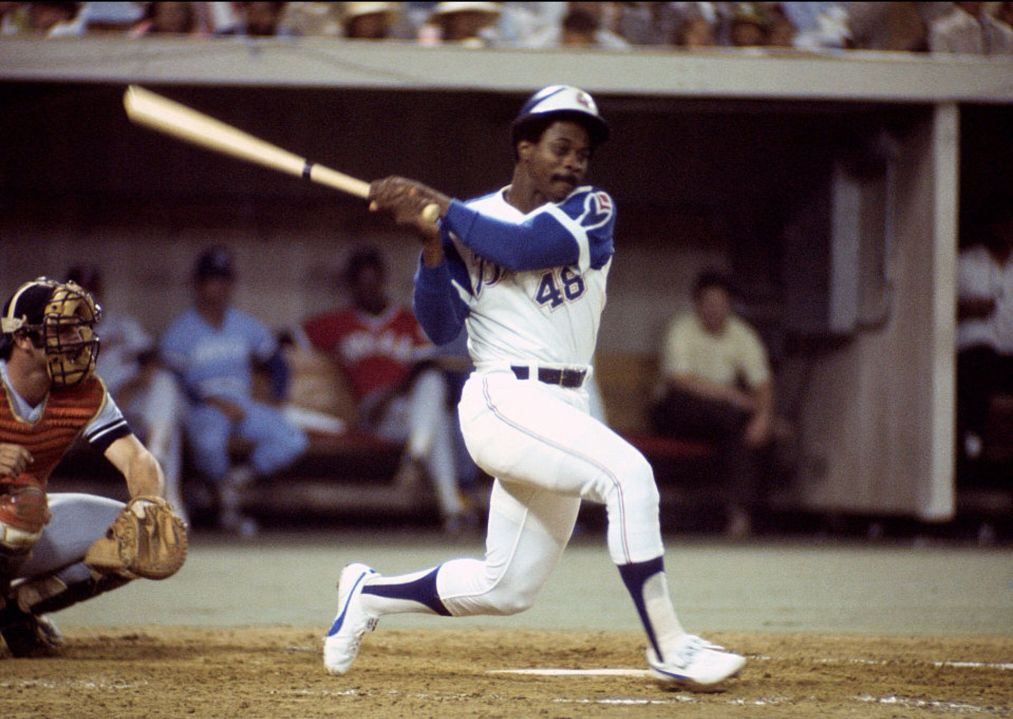
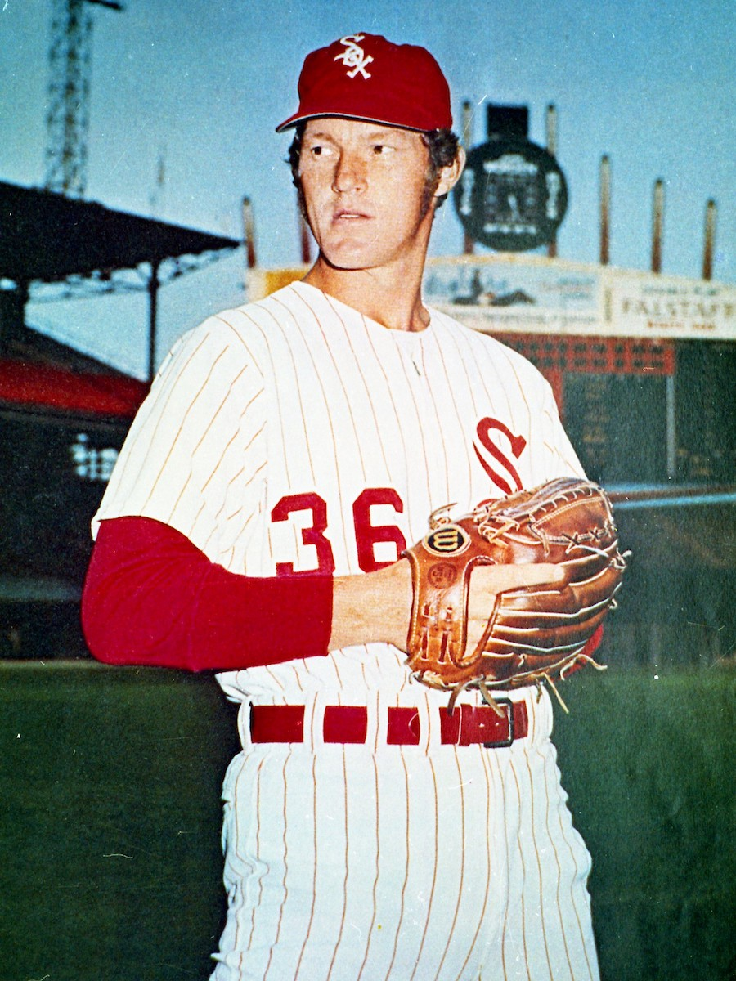
1974
Garr
Rudi
LEAGUE LEADERS
AVG – Ralph Garr, WSox (.349)
HR- Joe Rudi, SVS (19)
RBI- Joe Rudi, SVS (58)
SB- Lou Brock, HHH (57)
ERA – Jim Rooker, SVS, Jim Kaat, REK (2.00)
Wins- Buzz Capra, Chico’s (12)
Strikeouts – Fergie Jenkins, WSox (113)
Saves – Bill Campbell, HHH, Grant Jackson, 45ers (14)
Kaat

Slide 21
1974
Long Haul Champions
Druk U
Dave Druk

Slide 22
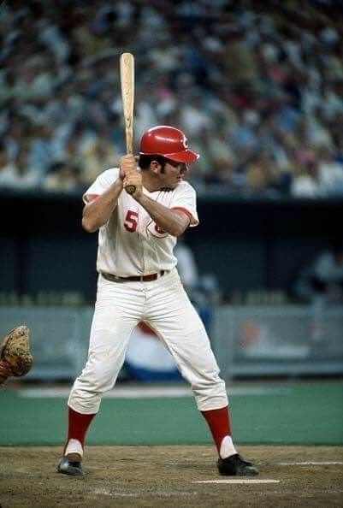
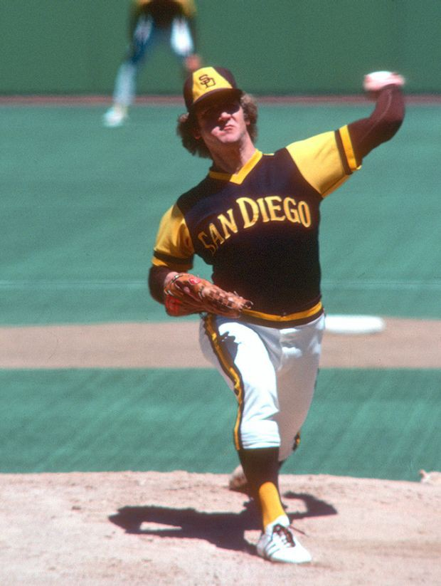
1975
Johnny Bench
Randy Jones
MVP Cy Young
Johnny Bench, SVS 1. Randy Jones, OO
Randy Jones, OO 2. Gaylord Perry, OO
Tony Solaita, REK 3. Don Sutton, REK

Slide 23
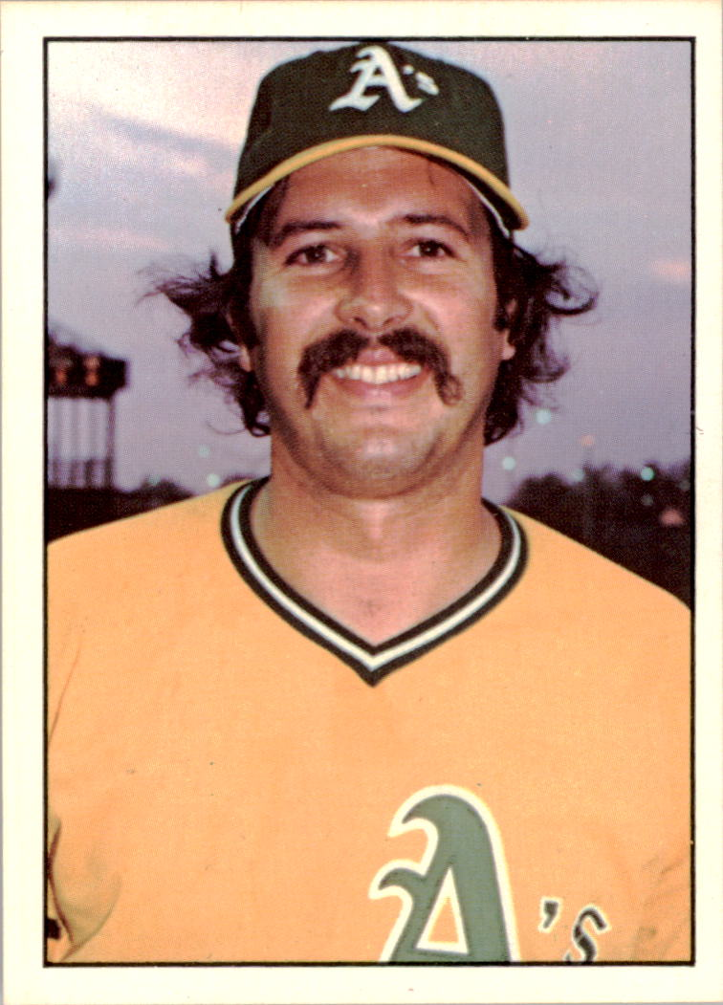
1975
MANAGER OF THE YEAR
LARRY
RIDGEWAY
Jim Todd
Fireman of the Year Manager
Jim Todd, SVS 1. Larry Ridgeway, REK
Will McEnany, REK 2. Dev Toth, Tampico
Rollie Fingers, WSox 3. Jay Demarest, Olney

Slide 24
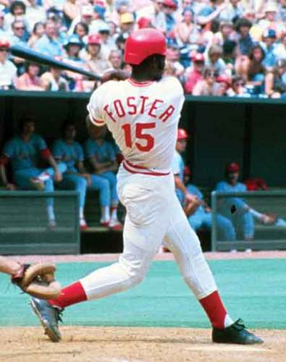
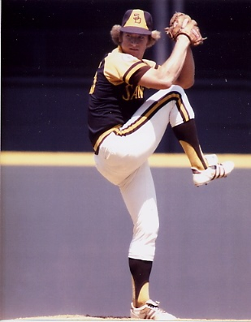
1975
Foster
Bench
LEAGUE LEADERS
AVG – George Foster, Stogies (.320)
HR- Tony Solaita, REK (25)
RBI- Johnny Bench, SVS (66)
SB- Mickey Rivers, FWS (44)
ERA – Randy Jones, OO (1.88)
Wins- Randy Jones, OO (14)
Strikeouts – Frank Tanana, DrukU/FWS (115)
Saves – Will McEnany, REK (12)
Jones

Slide 25
1975
Long Haul Champions
Olney Ogres
Jay Demarest

Slide 26
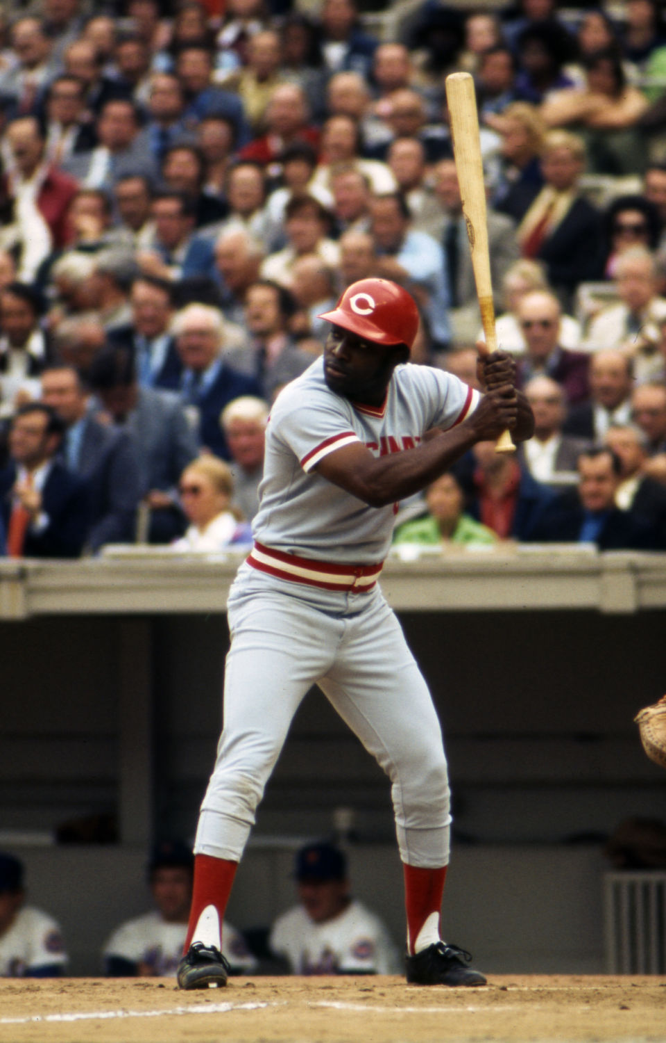
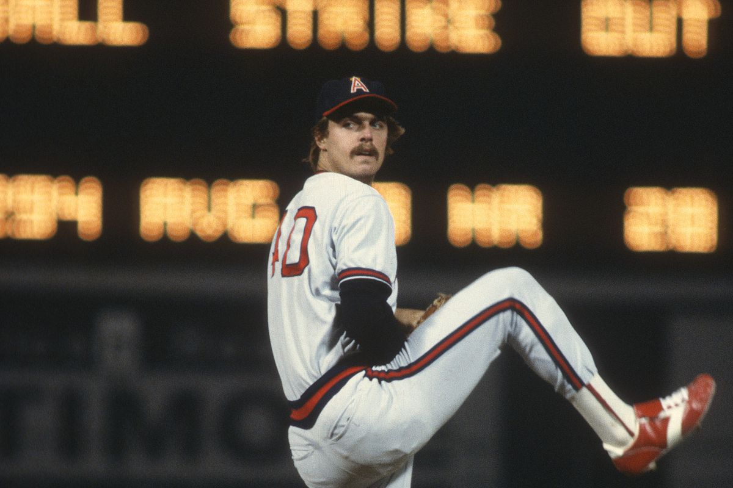
1976
Frank Tanana
Joe Morgan
MVP Cy Young
Joe Morgan, DrukU 1. Frank Tanana, FWS
Rod Carew, DrukU 2. Vida Blue, Stogies
George Foster, Stogies 3. Gary Nolan, SVS

Slide 27
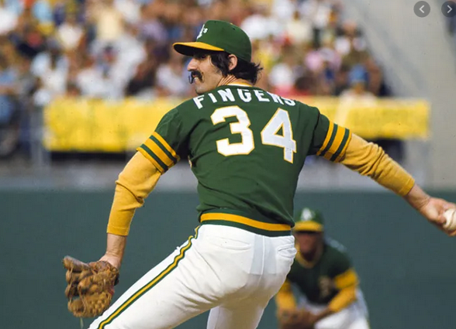
1976
MANAGER OF THE YEAR
JOE
DEAUSEAULT
Rollie Fingers
Fireman of the Year Manager
Rollie Fingers, WSox 1. Joe Deauseault, WSox
Rawley Eastwick, SVS 2. Mark Swindell, FWS
Charlies Hough, BPM 3. Ken Schulz, SVS

Slide 28
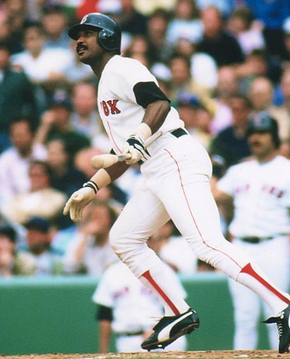
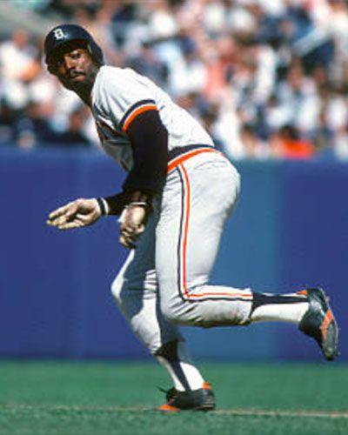
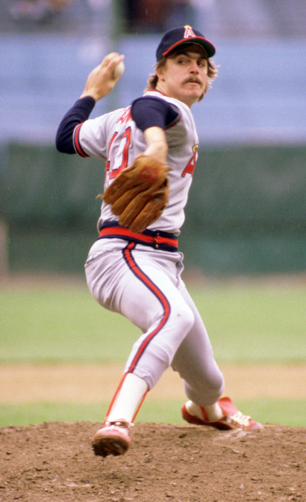
1976
Rice
Le Flore
LEAGUE LEADERS
AVG – Rod Carew, DrukU (.350)
HR- Jim Rice, BPM (19)
RBI- Jim Rice, BPM (61)
SB- Ron LeFlore, WSox (47)
ERA – Wayne Garland, Gems (2.50)
Wins- Frank Tanana, FWS (13)
Strikeouts – Frank Tanana, FWS (124)
Saves – Rollie Fingers, Wsox (15)
Tanana

Slide 29
1976
Long Haul Champions
Shenango Valley Storm
Ken Schulz

Slide 30
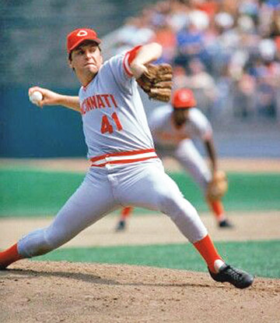
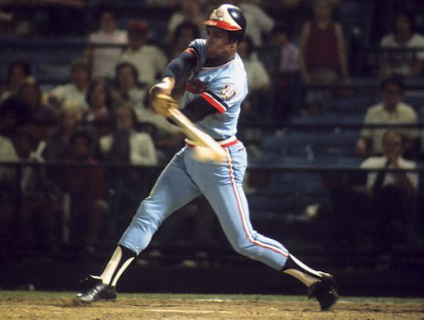
1977
Rod Carew
Tom Seaver
MVP Cy Young
Rod Carew, DrukU 1. Tom Seaver, Gems
Bill Robinson, LUC 2. Steve Carlton, BPM
George Foster, Stogies 3. John Candelaria, REK
3. Nino Espinosa, DrukU

Slide 31
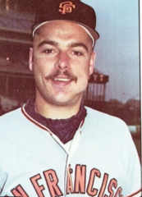
1977
MANAGER OF THE YEAR
Ken schulz
Dave Heaverlo
Fireman of the Year Manager
Dave Heaverlo, FWS 1. Ken Schulz, SVS
Enrique Romo, SVS 2. Dave Druk, DrukU
Gene Garber, BPM 3. Jim Miller, Gems

Slide 32
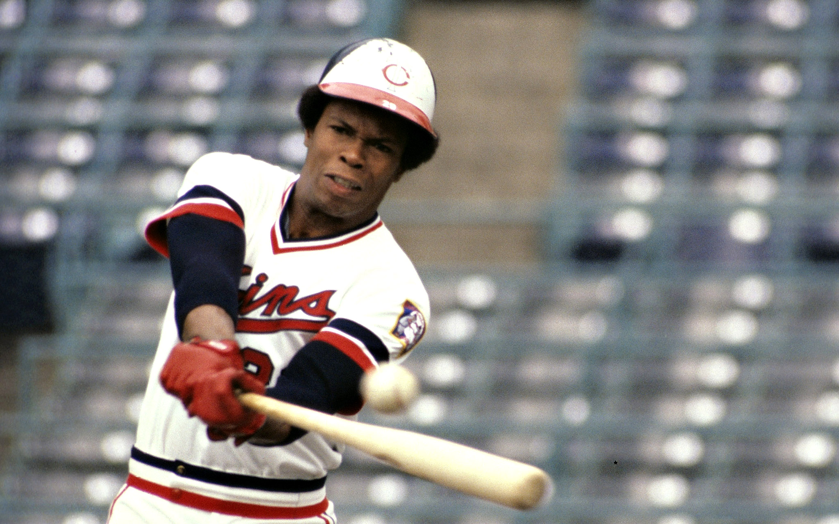
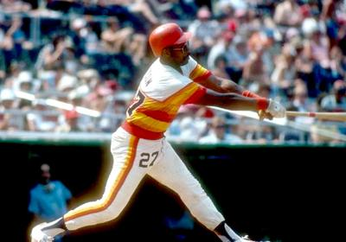
1977
Watson
Carew
LEAGUE LEADERS
AVG – Rod Carew, DrukU (.374)
HR- Willie Stargell, REK (26)
RBI- Bob Watson, DrukU (70)
SB- Cesar Cedeno, Gems (46)
ERA – John Candelaria, REK (2.28)
Wins- Tom Seaver, Gems (13)
Strikeouts – Ron Guidry, JAX (158)
Saves – Gene Garber, REK (13)
Seaver

Slide 33
1977
Long Haul Champions
Gems
Jim Miller

Slide 34
1978
Mike Vail
Mike Caldwell
MVP Cy Young
Mike Vail, LUC 1. Mike Caldwell, Oysters
Ron Cey, CBB 2. Bob Knepper, Gems
Al Oliver, WSox 3. Frank Tanana, Gems

Slide 35
1978
MANAGER OF THE YEAR
JIM MILLER
Dave LaRoche
Fireman of the Year Manager
Dave LaRoche, FWS 1. Jim Miller, Gems
Gene Garber, REK 2. Joe Deauseault WSox
Rollie Fingers, WSox 3. Andy Luckhaupt, LUC

Slide 36
1978
Horner
Dilone
LEAGUE LEADERS
AVG – Mike Vail, LUC (.332)
HR- Bob Horner, Jax (26)
RBI- George Foster, Tampico (65)
SB- Miguel Dilone, REK (72)
ERA – Mike Caldwell, Oysters (1.69)
Wins- Bob Knepper, Gems , Mike Caldwell Oysters(14)
Strikeouts – Ron Guidry, JAX (150)
Saves – Rollie Fingers, WSox (13)
Knepper

Slide 37
1978
Long Haul Champions
Ft Worth Swindlers
Mark Swindell

Slide 38
1979
Oscar Gamble
Dan Schatzeder
MVP Cy Young
Oscar Gamble, DOE 1. Dan Schatzeder, HHH
Jim Morrison, REK 2. Gaylord Perry, LUC/FWS/BPM
Sixto Lezcano, CBH 3. Tom Seaver, Hemp

Slide 39
1979
MANAGER OF THE YEAR
Ken schulz
Bruce Sutter
Fireman of the Year Manager
Bruce Sutter, DOE 1. Ken Schulz, SVS
Greg Minton, JUM 2. AJ Luckhaupt, BPM
Jim Kern, BPM 3. Tim Leslie, DOE

Slide 40
1979
Spencer
Morrison
LEAGUE LEADERS
AVG – Oscar Gamble, DOE (.374)
HR- Jim Spencer, BPM (27)
RBI- Jim Morrison, REK (78)
SB- Willie Wilson, CBH (50)
ERA – Pete Redfern, Gems (2.21)
Wins- Gaylord Perry, LUC/FWS/BPM (14)
Strikeouts –Ron Guidry, JAX (137)
Saves – Jim Kern, BPM (14)
Perry

Slide 41
1979
Long Haul Champions
Jacksonville Braves
John Cody

Slide 42
1980
Lonnie Smith
Mike Norris
MVP Cy Young
Lonnie Smith, FWS 1. Mike Norris, Gems
George Brett, WSox 2. Steve Stone, Doe Run
Mike Schmidt, FWS 3. Jerry Reuss, Jumble

Slide 43
1980
MANAGER OF THE YEAR
Mark swindell
Dan Quisenberry
Fireman of the Year Manager
Dan Quisenberry, WOBs 1. Mark Swindell, FWS
Dave Smith, WSox 2. Jim Miller, Gems
JR Richard, Bears/SVS 3. Gil Palladino, WOBs

Slide 44
1980
Jackson
Schmidt
LEAGUE LEADERS
AVG – Lonnie Smith, FWS (.340)
HR- Reggie Jackson, Jax/SVS (27)
RBI- Mike Schmidt, FWS (75)
SB- Ron LeFlore, WSox (55)
ERA – Mike Norris, Gems (1.76)
Wins- Mike Norris/Vern Ruhle, Gems (13)
Strikeouts – Steve Carlton, FWS (167)
Saves – Dave Smith, WSox (15)
Carlton

Slide 45
1980
Long Haul Champions
Westfield Sox
Joe Deauseault

Slide 46
1981
Mike Schmidt
Dave Righetti
MVP Cy Young
Mike Schmidt, FWS 1. Dave Righetti, WOBs
Rickey Henderson, JUM 2. Tom Seaver, Hemp/FWS
Kirk Gibson, Gems 3. Nolan Ryan, WSox

Slide 47
1981
MANAGER OF THE YEAR
Mark swindell
Jeff Reardon
Fireman of the Year Manager
Jeff Reardon, CBH 1. Mark Swindell, FWS
Dave LaRoche, FWS 2. Joe Deauseault, WSox
Rick Camp, REK 3. Jim Miller, Gems

Slide 48
1981
Raines
Henderson
LEAGUE LEADERS
AVG – Rickey Henderson, Jumble (.327)
HR- Mike Schmidt, FWS (26)
RBI- Mike Schmidt, FWS (69)
SB- Tim Raines, Wsox (78)
ERA – Nolan Ryan, Wsox (1.98)
Wins- Tom Seaver, Hemp/FWS (16)
Strikeouts – Dave Righetti, WOBs (152)
Saves – Jeff Reardon, CBH (19)
Ryan

Slide 49
1981
Long Haul Champions
Gems
Jim Miller

Slide 50
1982
Al Oliver
Steve Carlton
John Lowenstein
MVP Cy Young
John Lowenstein, JUM 1. Steve Carlton, FWS
1. Al Oliver, FWS (TIE) 2. Larry Christenson, JUM
3. Hal McRae, CBH 3. Rick Sutcliffe, WOB

Slide 51
1982
MANAGER OF THE YEAR
Mark swindell
Dave Dravecky
Fireman of the Year Manager
Dave Dravecky, 45ers 1. Mark Swindell, FWS
Luis DeLeon, FLY 2. Paul Davidson, JUM
Goose Gossage, REK 3. Joe Summers, CBH

Slide 52
1982
Oliver
Christenson
LEAGUE LEADERS
AVG – Al Oliver, FWS (.342)
HR- John Lowenstein, JUM (25)
RBI- Al Oliver, FWS (69)
SB- Rickey Henderson, Druk (68)
ERA – Larry Christenson, Druk (2.67)
Wins- Steve Carlton, FWS / Larry Christenson (13)
Strikeouts – Mario Soto, Jum/Sox (162)
Saves – Dave Dravecky, 45ers (13)
Soto

Slide 53
1982
Long Haul Champions
Druk U
Dave Druk

Slide 54
1983
Wade Boggs
Atlee Hammaker
MVP Cy Young
Wade Boggs, BPM 1. Atlee Hammaker, JAX/FWS
2. Lance Parrish, CBH 2. Rick Honeycutt, Doe Run
3. Tim Raines, WSox 3. John Denny, BPM

Slide 55
1983
MANAGER OF THE YEAR
MaRK swindell
Dan Quisenberry
Fireman of the Year Manager
Dan Quisenberry, FW 1. Mark Swindell, FWS
Jesse Orosco, DrukU 2. Matt DeMello, BPM
Pat Zachry, CBH/JUM 3. Tim Leslie, Doe Run

Slide 56
1983
Barfield
Ripken
LEAGUE LEADERS
AVG – Wade Boggs, BPM (.347)
HR- Jesse Barfield, Hemp (25)
RBI- Cal Ripken, BPM (70)
SB- Rickey Henderson, Druk (67)
ERA – Atlee Hammaker, JAX/FWS (2.38)
Wins- Charlie Lea, Bears (12)
Strikeouts – Jack Morris, HHH (138)
Saves – Dan Quisenberry, FWS (17)
Lea

Slide 57
1983
Long Haul Champions
Ft Worth Swindlers
Mark Swindell

Slide 58
1984
Dale Murphy
Bert Blyleven
MVP Cy Young
Dale Murphy, SVS 1. Bert Blyleven, SVS
2. Ryne Sandberg, SVS 2. Rick Rhoden, Hemp
3. Tony Gwynn, Hemp 3. Fernando Valenzuela, BPM

Slide 59
1984
MANAGER OF THE YEAR
KEN SCHULZ
Larry Andersen
Fireman of the Year Manager
Larry Andersen, Doe/45 1. Ken Schulz, SVS
Jesse Orosco, DrukU 2. Allen Smith, 45s
Dave Smith, Sox 3. Joe Summers, CBH

Slide 60
1984
Gwynn
Murphy
LEAGUE LEADERS
AVG – Tony Gwynn, Hemp (.388)
HR- Dale Murphy, SVS (26)
RBI- Dale Murphy, SVS (81)
SB- Tim Raines, WSox (37)
ERA – Joe Niekro, BPM (2.35)
Wins- Bert Blyleven, SVS (15)
Strikeouts – Rick Sutcliffe, WOB/FW/SVS (125)
Saves – Larry Andersen, Doe/45s (19)
Sutcliffe

Slide 61
1984
Long Haul Champions
Shenango Valley Storm
Ken Schulz

Slide 62
1985
Pedro Guerrero
Bert Blyleven
MVP Cy Young
Pedro Guerrero, Wsox 1. Bert Blyleven, SVS
2. Floyd Rayford, Gems 2. John Tudor, WSox
3. Willie McGee, Doe 3. Ron Darling, SVS

Slide 63
1985
MANAGER OF THE YEAR
KEN SCHULZ
Dan Quisenberry
Fireman of the Year Manager
Dan Quisenberry, SVS 1. Ken Schulz, SVS
Jeff Lahti, FWS 2. Jim Miller, Gems
Brian Fisher, WSox 3. Tim Leslie, Doe Run

Slide 64
1985
McGee
Fisk
LEAGUE LEADERS
AVG – Willie McGee, Doe Run (.359)
HR- Carlton Fisk, WSox (24)
RBI- Floyd Rayford, Gems (73)
SB- Tim Raines, WSox (56)
ERA – Bert Blyleven, SVS (1.73)
Wins- Ron Darling, SVS (14)
Strikeouts – Dwight Gooden, 45s/DrukU (168)
Saves – Dan Quisenberry, SVS (15)
Gooden

Slide 65
1985
Long Haul Champions
Gems
Jim Miller

Slide 66
1986
Jesse Barfield
Mike Scott
MVP Cy Young
Jesse Barfield, Hemp 1. Mike Scott, WSox
2. Tim Raines, WSox 2. Ron Guidry, 45ers
3. Kirk Gibson, DrukU 3. Bob Ojeda, Hemp

Slide 67
1986
MANAGER OF THE YEAR
MARK PARIS
Dale Mohorcic
Fireman of the Year Manager
Dale Mohorcic, DrukU 1. Mark Paris, Hemp
Frank Williams, Hemp 2. Ken Schulz, SVS
Dan Quisenberry, SVS 3. Joe Deauseault, WSox

Slide 68
1986
Raines
Bell
LEAGUE LEADERS
AVG – Tim Raines, Wsox (.327)
HR- Jesse Barfield, Hemp (29)
RBI- Jesse Barfield, Hemp (80)
SB- Rickey Henderson, Gems (49)
ERA – Bob Ojeda, Hemp (2.52)
Wins- Mike Scott, Wsox (14)
Strikeouts – Teddy Higuera, BPM / Roger Clemens, WOB (152)
Saves – Dale Mohorcic, DrukU (16)
Ojeda

Slide 69
1986
Long Haul Champions
Shenango Valley Storm
Ken Schulz

Slide 70
1987
Wade Boggs
Nolan Ryan
MVP Cy Young
Wade Boggs, BPM 1. Nolan Ryan, WSox
2. Mark McGwire, HHH 2. Jim Clancy, HHH
3. Jack Clark, BPM 3. Jimmy Key, WOB

Slide 71
1987
MANAGER OF THE YEAR
GREGG WISEBURN
Tim Burke
Fireman of the Year Manager
Tim Burke, DrukU 1. Gregg Wiseburn, HHH
Dave Smith, Tamp 2. Mark Swindell, FWS
Terry Leach, Gems 3. Joe Summers, CBH

Slide 72
1987
Clark
McGwire
LEAGUE LEADERS
AVG – Wade Boggs, BPM (.376)
HR- Mark McGwire, HHH (32)
RBI- Jack Clark, BPM (83)
SB- John Cangelosi, BPM (57)
ERA – Don Gordon, Hemp (2.65)
Wins- Joe Magrane CBH/Nolan Ryan WSox/Jim Clancy HHH/Terry Leach Gems (13)
Strikeouts – Nolan Ryan, Sox (128)
Saves – Tim Burke, DrukU (14)
Leach

Slide 73
1987
Long Haul Champions
Hyannis Harborhawks
Gregg Wiseburn

Slide 74
Top seasonal records-batters

Slide 75
Top seasonal records-batters

Slide 76
Top seasonal records-pitchers

Slide 77
Top seasonal records-pitchers

Slide 78
Top seasonal records-TEAMS BATTING

Slide 79
Top seasonal records-TEAMS pitching

Slide 80
WORLD LONG HAUL CHAMPIONS
1970 – Lester A’s (over ridges rek)
1971 – Big Pink Machine (over Jacksonville braves)
1972 – Olney Ogres (over big pink machine)
1973 – Olney Ogres (over gems)
1974 – Druk U (over shenango valley storm)
1975 – Olney Ogres (over TAMPICO STOGIES)
1976 – Shenango Valley Storm (over DRUK U)
1977 – Gems (Over westfield sox)
1978 - Ft Worth swindlers (over westfield sox)
1979 - Jacksonville braves (OVER Big pink machine)
1980 - WESTFIELD SOX (over ft worth swindlers)
1981 - GEMS (over westfield sox)
1982 - druk u (OVER CHESAPEAKE BAY HERONS)
1983 - ft worth swindlers (over doe run stampede)
1984 - SHENANGO VALLEY STORM (over 45ers)
1985 - GEMS (SHENANGO VALLEY STORM)
1986 - SHENANGO VALLEY STORM (OVER Kentucky Hemp)
1987 – Hyannis harborhawks (over ft worth swindlers)

Slide 81
Postseason appearances
Westfield sox – 1971, 1972, 1974, 1976, 1977, 1978, 1980, 1981, 1982, 1985, 1986, 1987 (12)
Gems – 1971, 1972, 1973, 1975, 1977, 1978, 1980, 1981, 1983, 1985, 1987 (11)
Shenango valley storm- 1974, 1975, 1976, 1977, 1979, 1983, 1984, 1985, 1986 (9)
Ft worth swindlers – 1976, 1977, 1978, 1980, 1981, 1982, 1983, 1985, 1987 (9)
Druk u – 1970, 1973, 1974, 1975, 1976, 1977, 1979, 1982 (8)
Olney ogres – 1970, 1971, 1972, 1973, 1974, 1975, 1976 (7)
West Coast jumble – 1980, 1981, 1982, 1984, 1985, 1986, 1987 (7)
Jacksonville braves – 1971, 1972, 1973, 1978, 1979, 1984 (6)
Chesapeake bay herons- 1981, 1982, 1983, 1984, 1987 (5)
Chico’s bail bonds/LUCASVILLE DARKSIDE – 1971, 1973, 1974, 1978 (4)
DOE RUN STAMPEDE – 1979, 1980, 1983, 1985 (4)
45ers – 1973, 1974, 1984 (3)
Rek – 1970, 1975, 1977 (3)
Westmoreland-Oriskany bulldogs – 1980, 1981, 1982 (3)
Big pink machine (AJ)– 1971, 1972, 1979 (3)
BIG PINK MACHINE (MATT) – 1983, 1984, 1986 (3)
HYANNIS HARBORHAWKS – 1978, 1979, 1987 (3)
Tampico stogies – 1975, 1976 (2)
Lester a’s - 1970, 1972 (2)
Kentucky Hemp – 1986 (1)
The Bears – 1986 (1)
L o n g H a u l

Slide 82
Seasonal divisional champions

Slide 83
Seasonal pennant winners

Slide 84
AWARD WINNERS BY SEASON

Slide 85
Long haul franchise HISTORY

